Slide 1
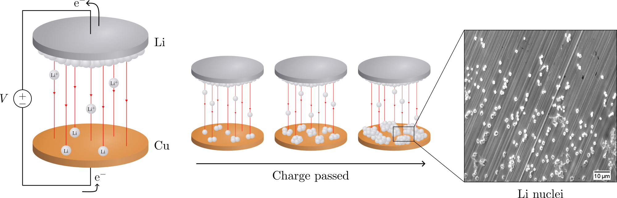
Electrochemical deposition of lithium on copper
Gottfrid Olsson
2024-05-21

Slide 2
PLAN: 25 minute presentation
Introduction:
Importance of batteries, improvements LMB>LIB (fig.), problems non-uniform growth (fig + in-depth), purpose of this thesis
Theory:
Homogenous nucleation theory; main results (fig.), how does eta impact r and N (fig.)?
Methods:
Cell assemblies (note importances; wave spring, no pressure); cycling protocol (fig.)
Results:
passivation of Cu; J-dep.; pressure (C-cell and T-cell, r & angle dep. and morphology)
Conclusion: 2 min
Passivation, J-dep. and pressure to achieve uniform deposition in LMBs
(Opposition and Questions from audience)

Slide 3
Batteries!

Slide 4
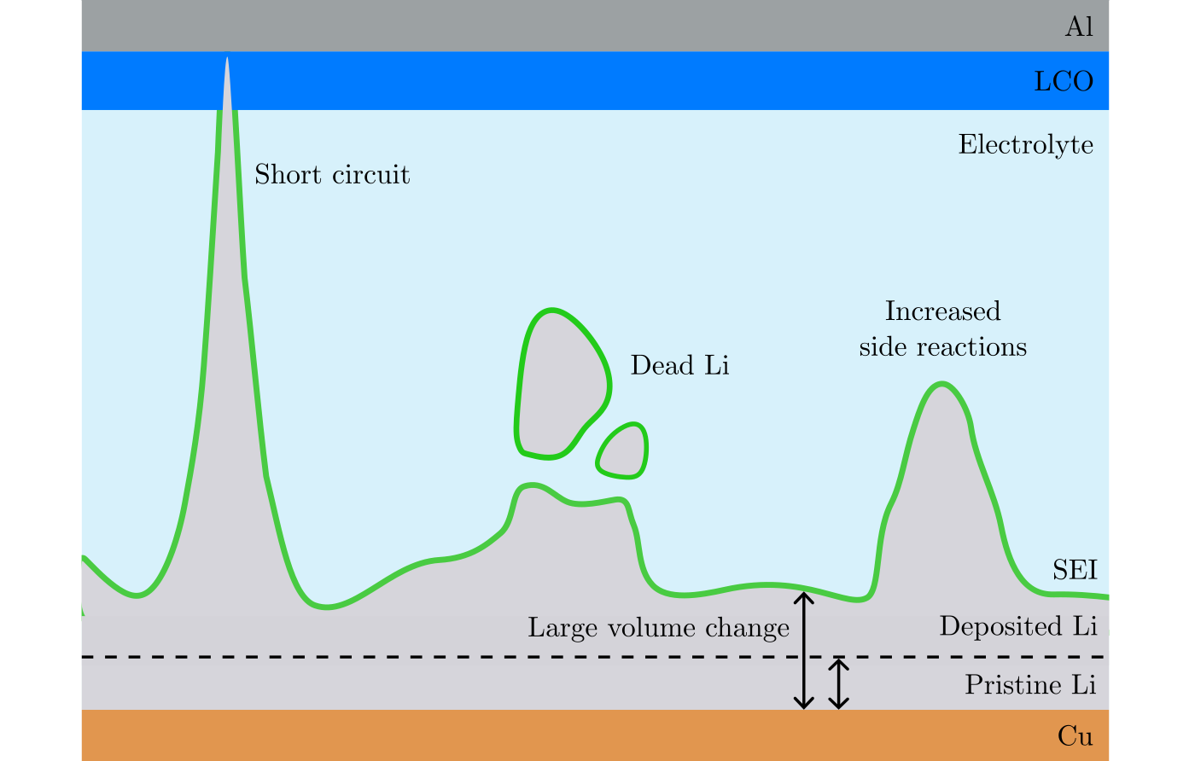
Non-uniform deposition problems

Slide 5
Purpose of this thesis
Investigate pressure, current, passivation

Slide 6
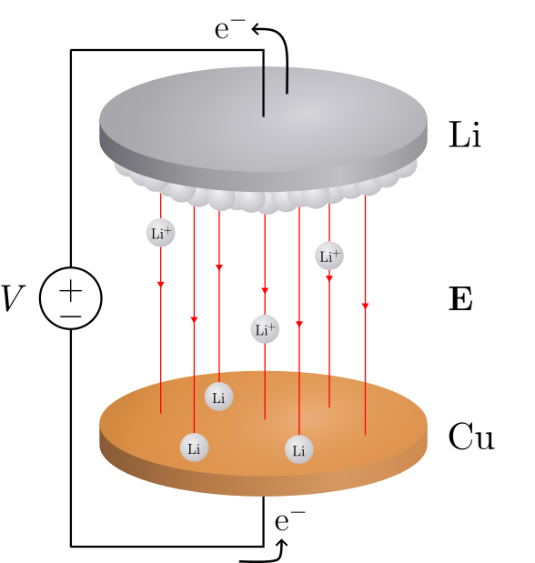
Deposition in a Li/Cu cell

Slide 7
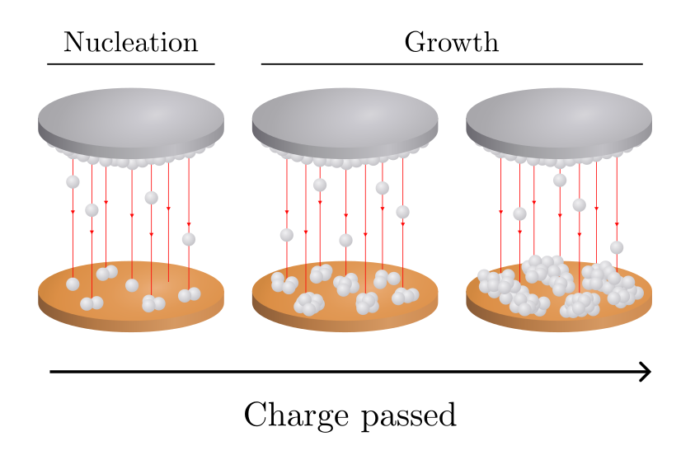
Deposition in a Li/Cu cell

Slide 8
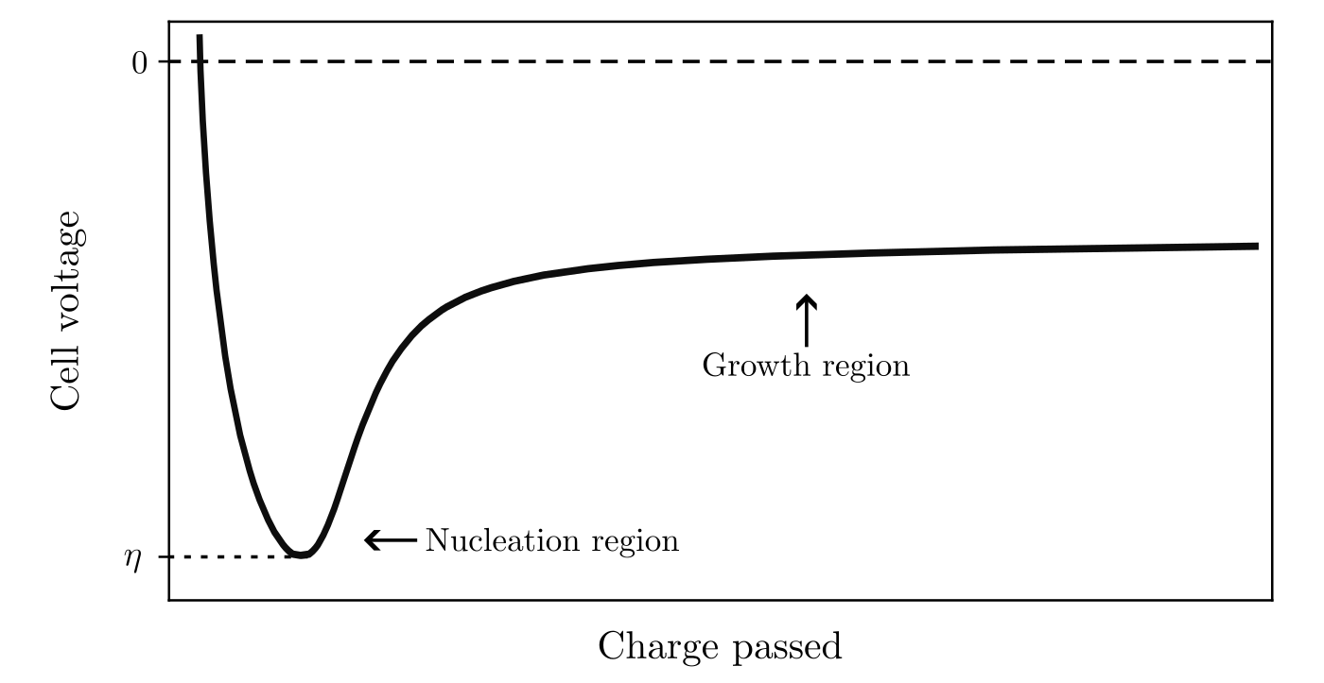
Deposition in a Li/Cu cell

Slide 9
Nucleation theory
//describe: nucleation here: form solid Li from a solution of Li+ (figure!)
Use thermodynamics to theoretically model this (next slide)

Slide 10
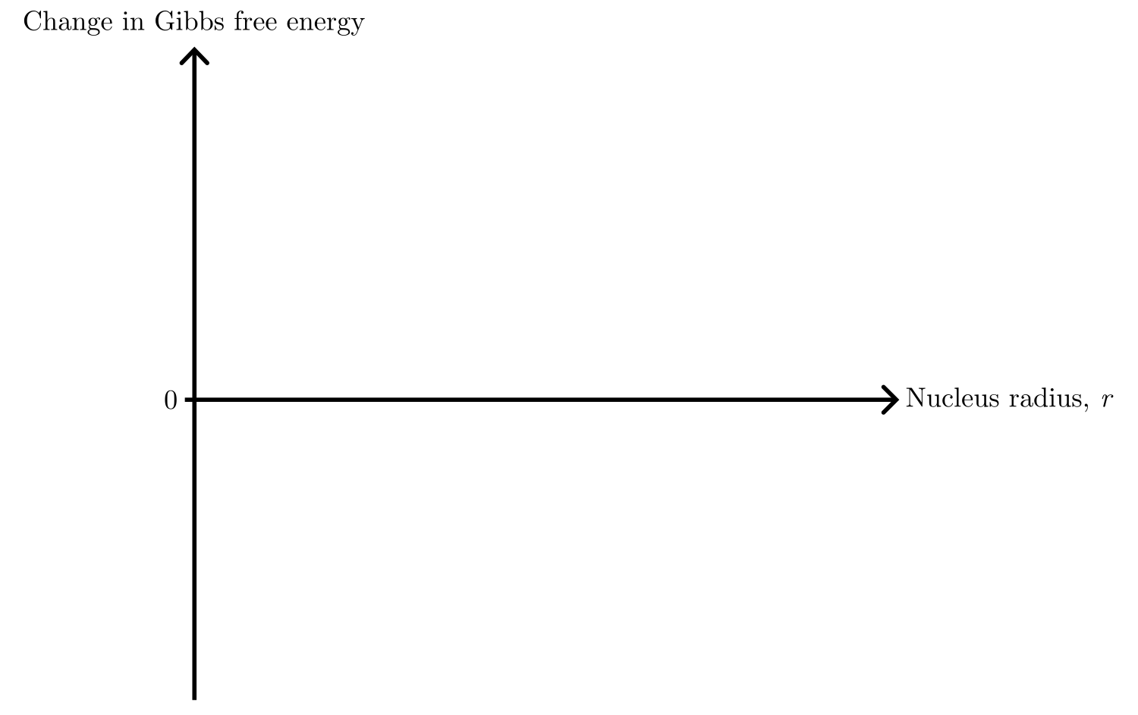
Nucleation theory

Slide 11
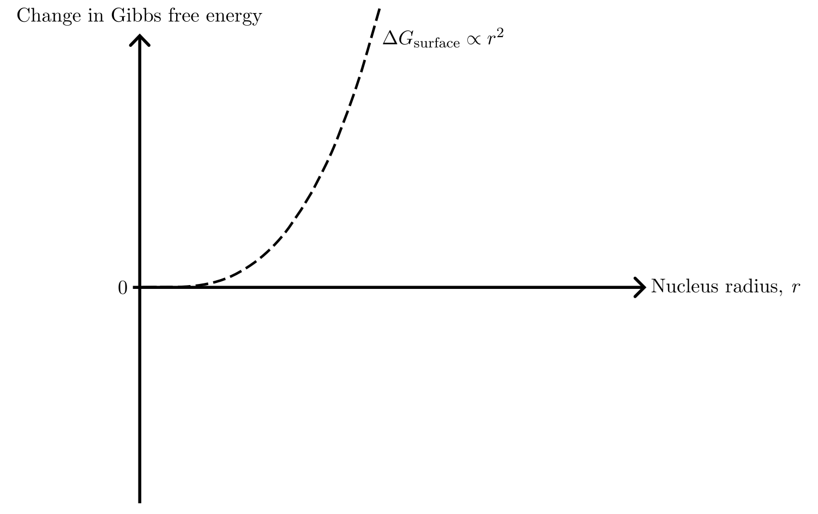
Nucleation theory

Slide 12
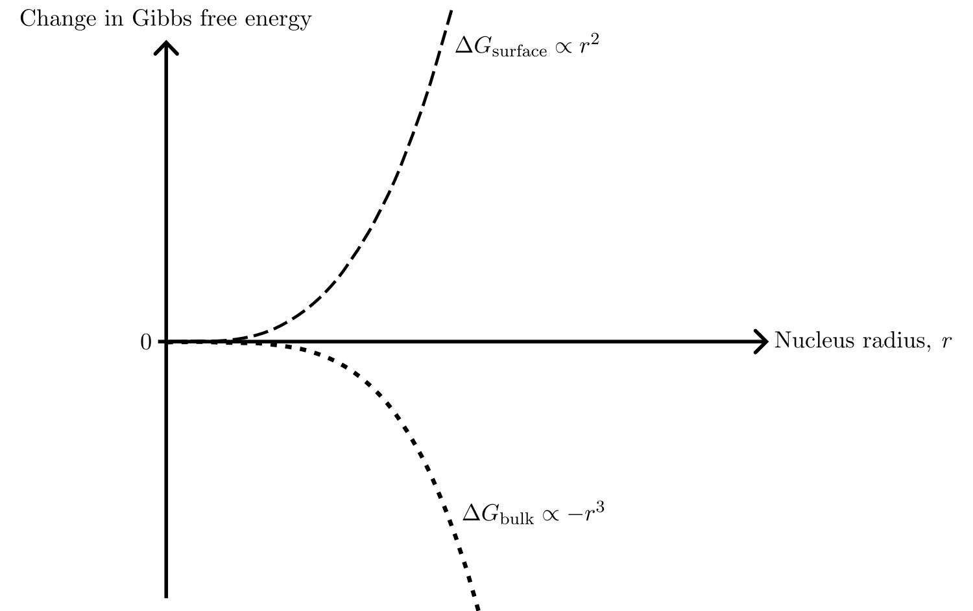
Nucleation theory

Slide 13
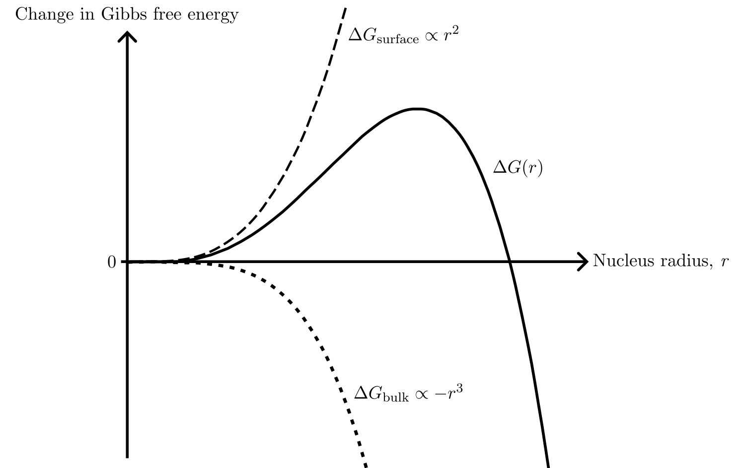
Nucleation theory

Slide 14
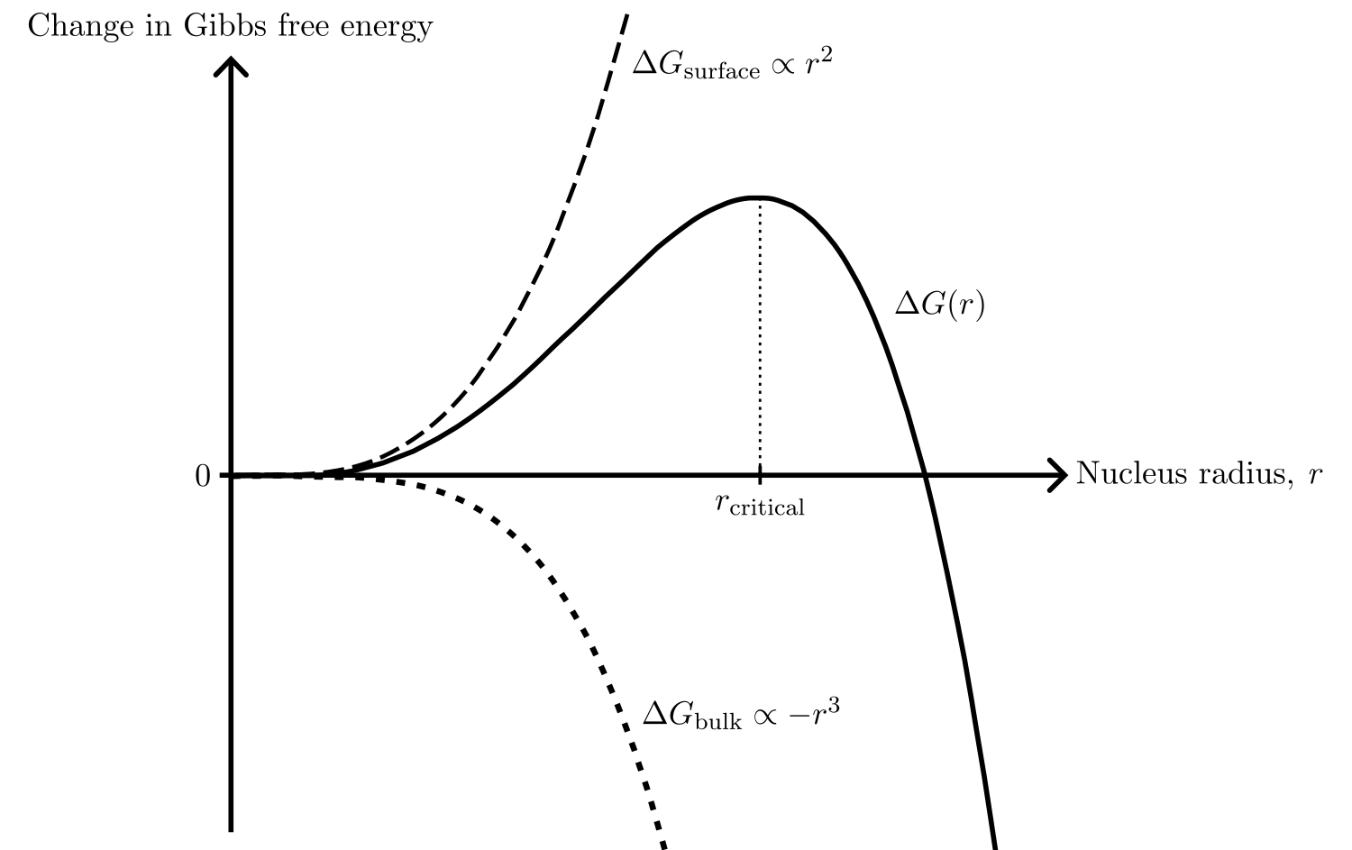
Nucleation theory

Slide 15
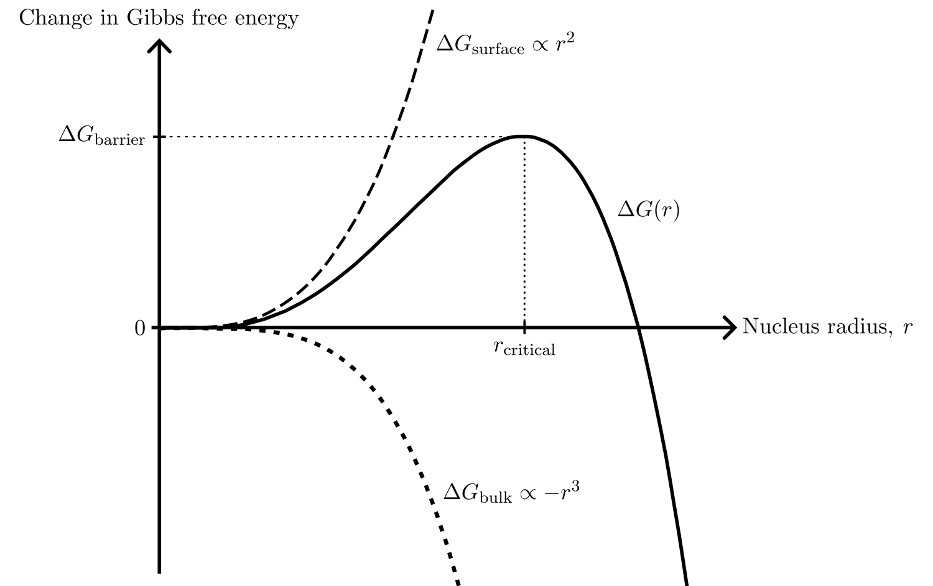
Nucleation theory

Slide 16
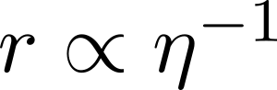
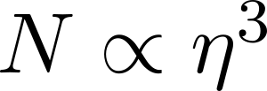
Nucleation theory

Slide 17
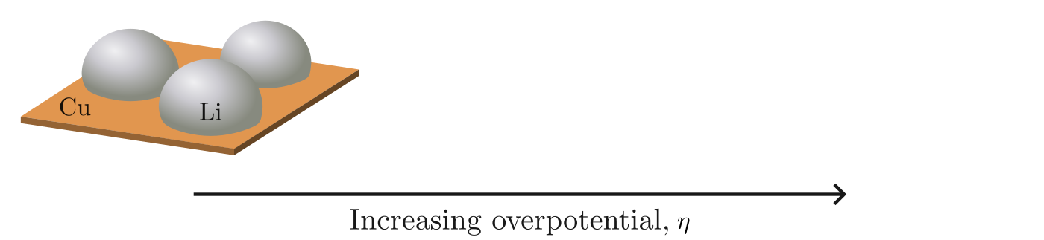
Nucleation theory

Slide 18
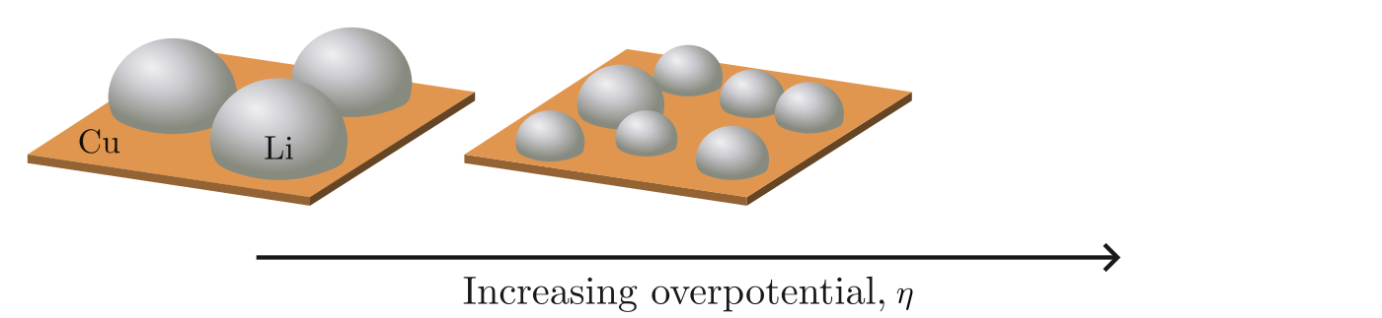
Nucleation theory

Slide 19
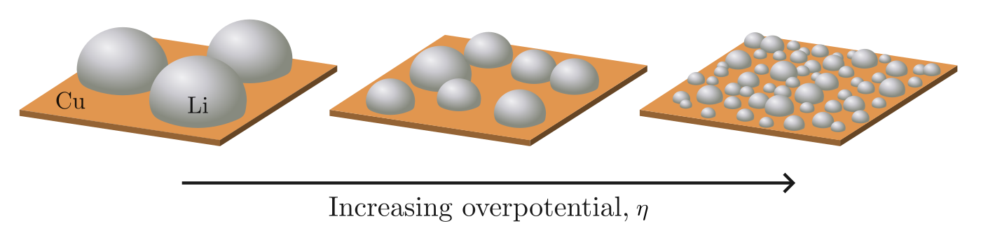
Nucleation theory

Slide 20
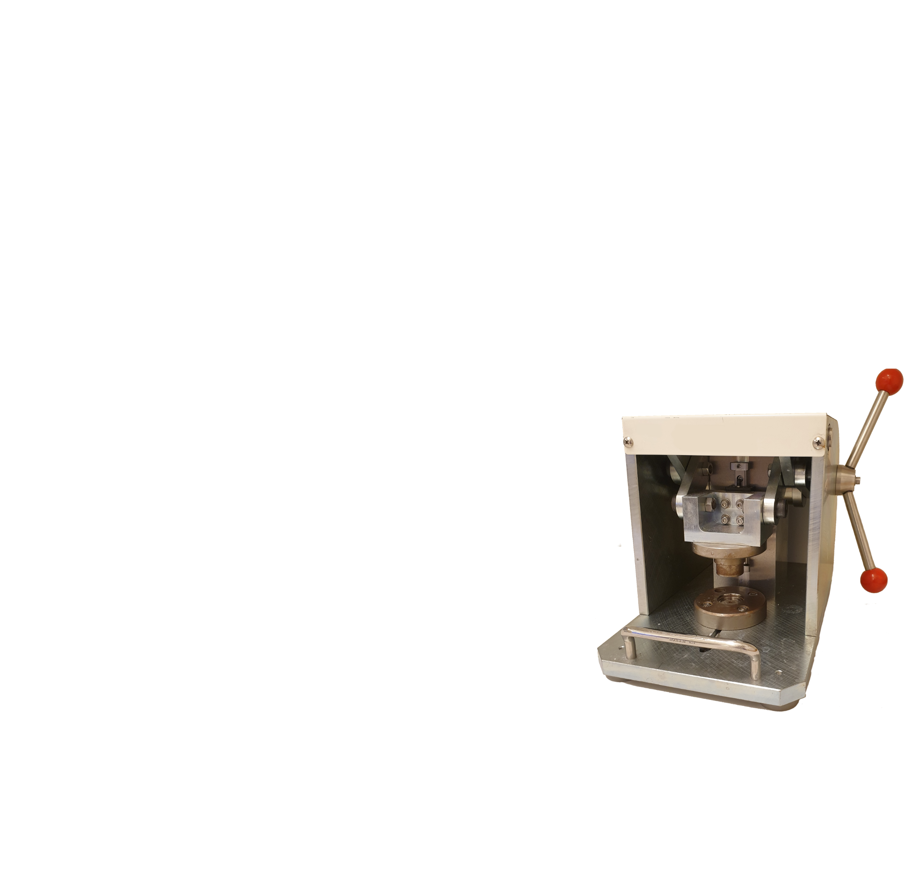
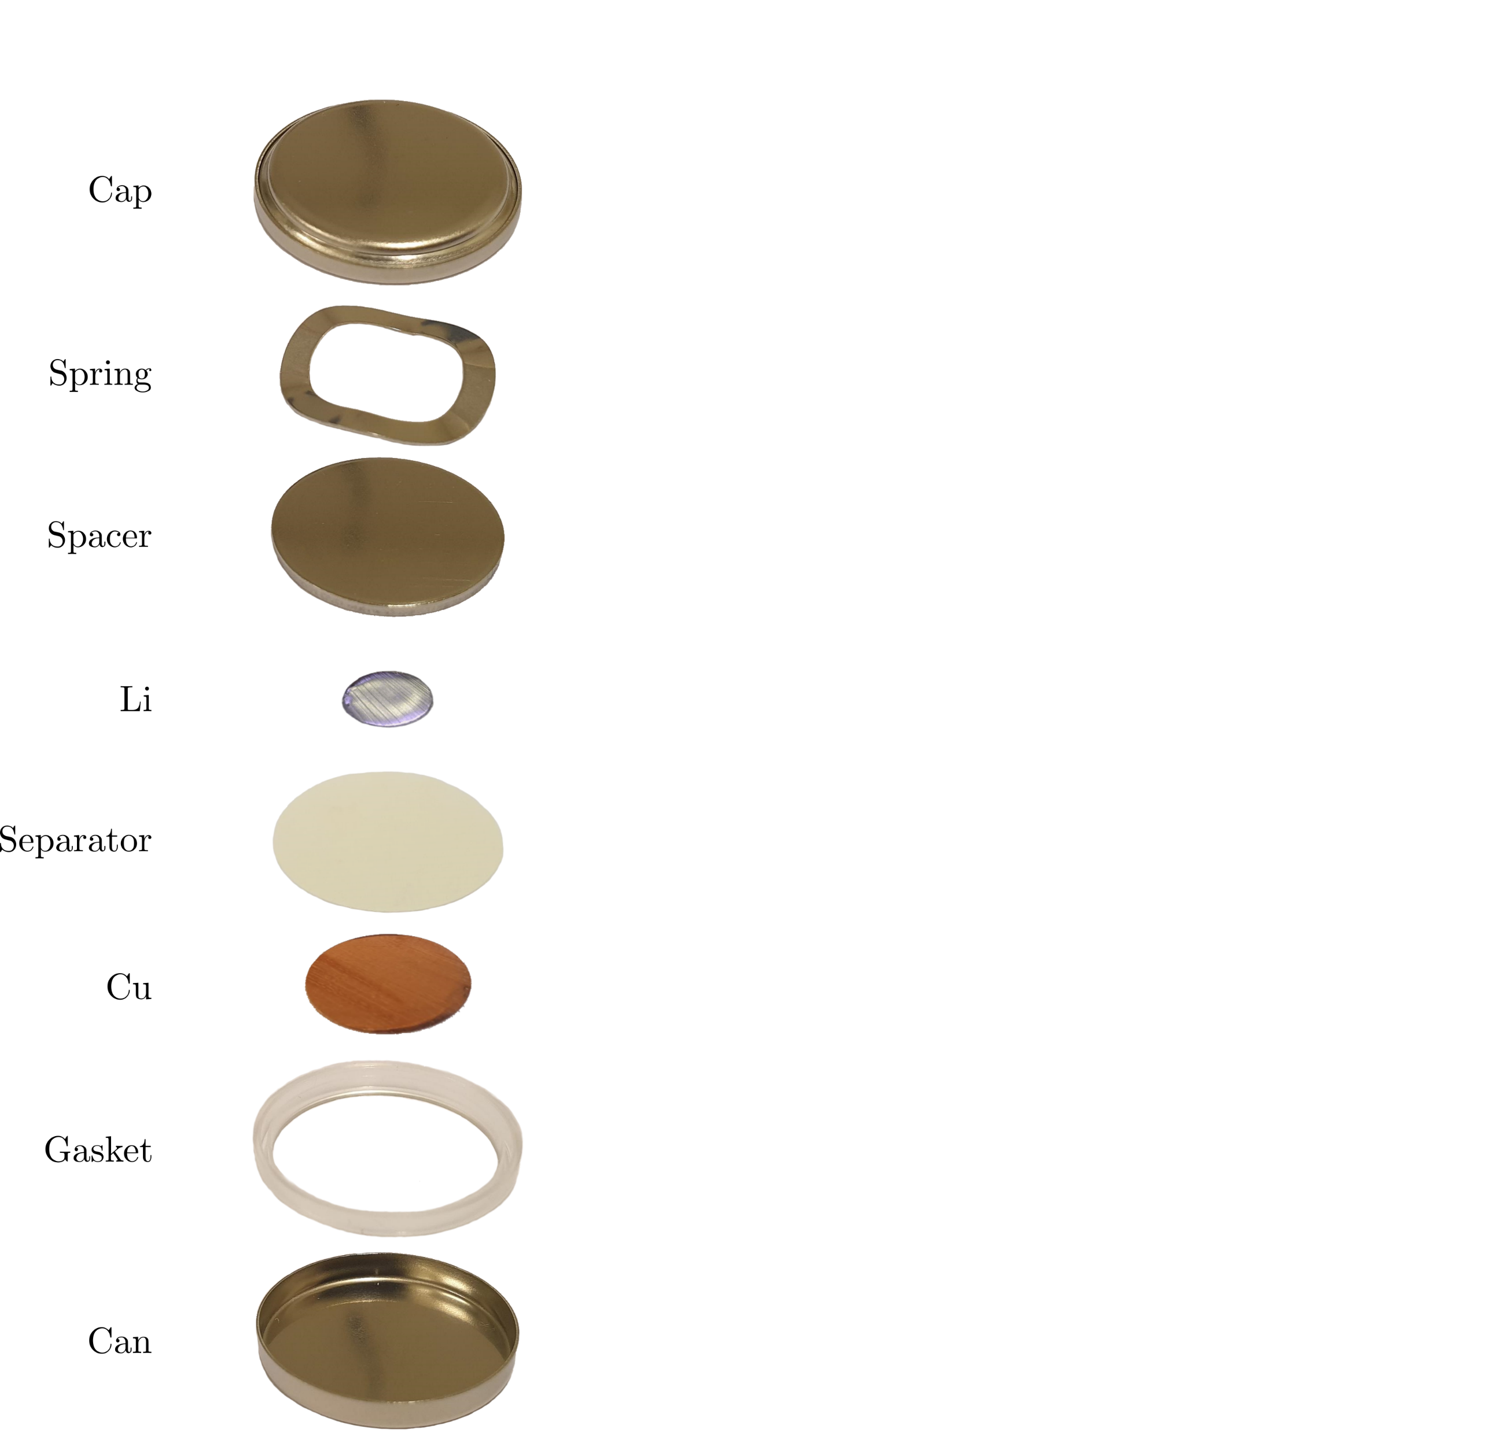
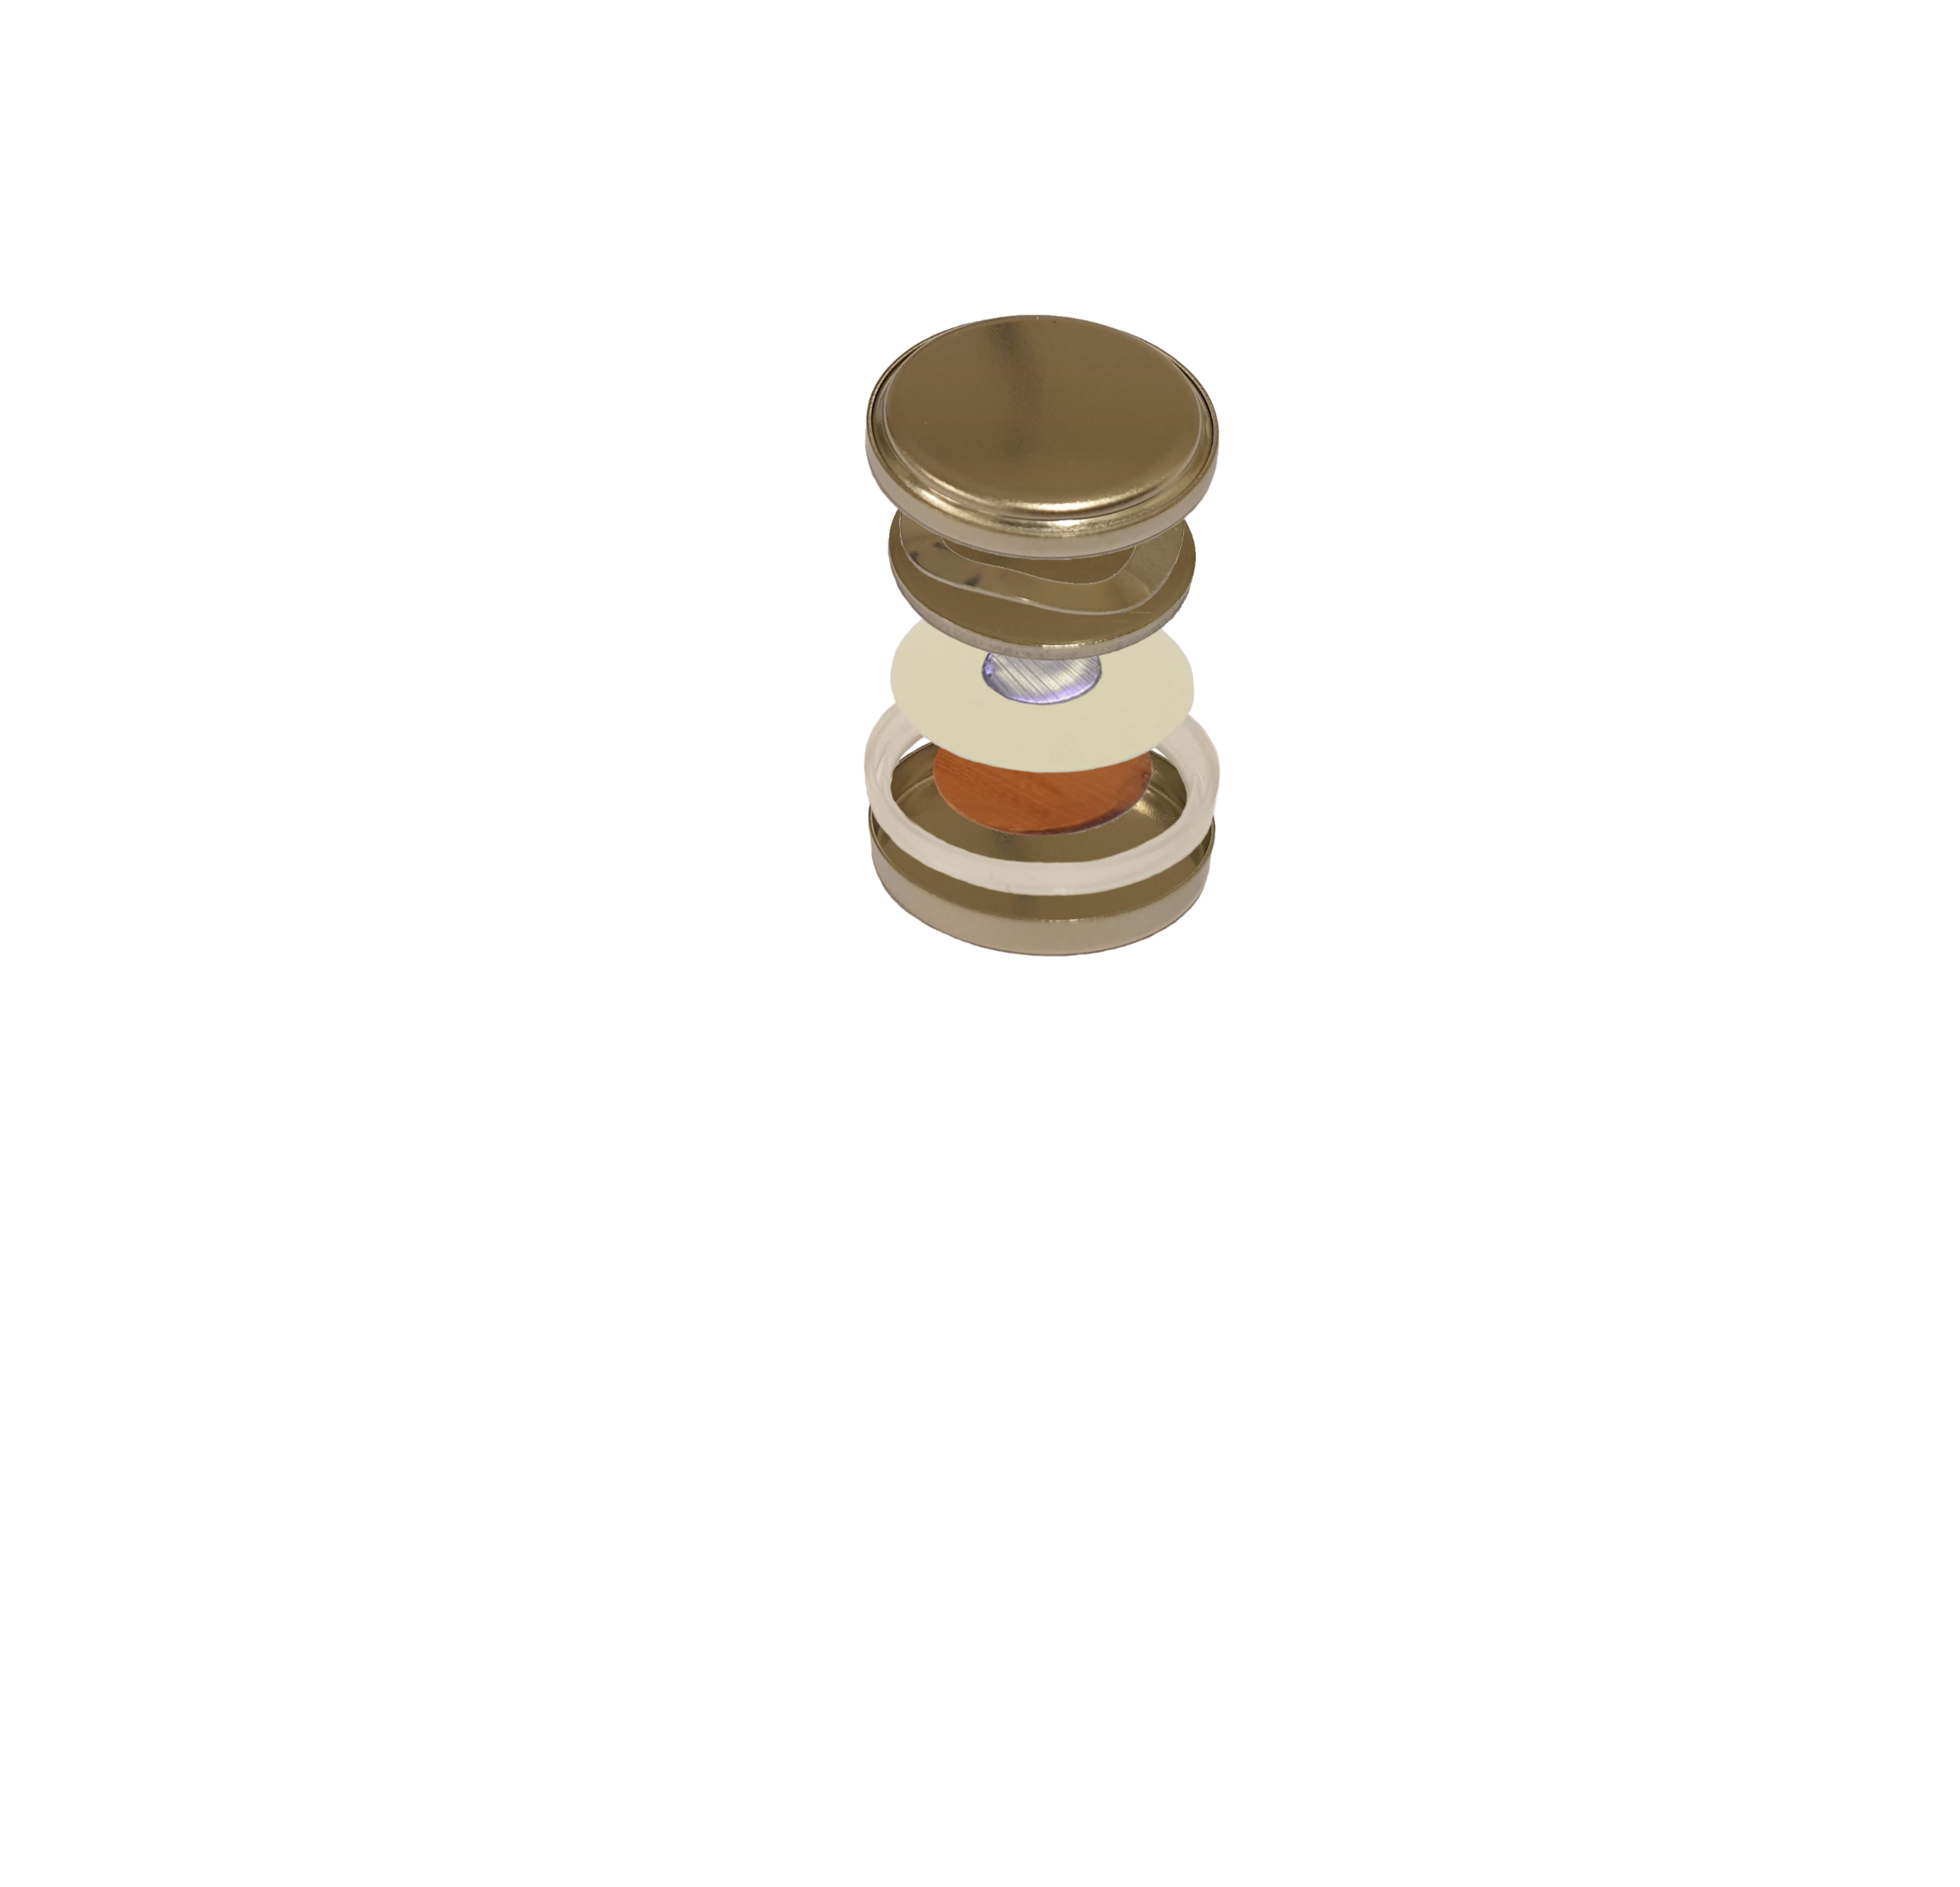
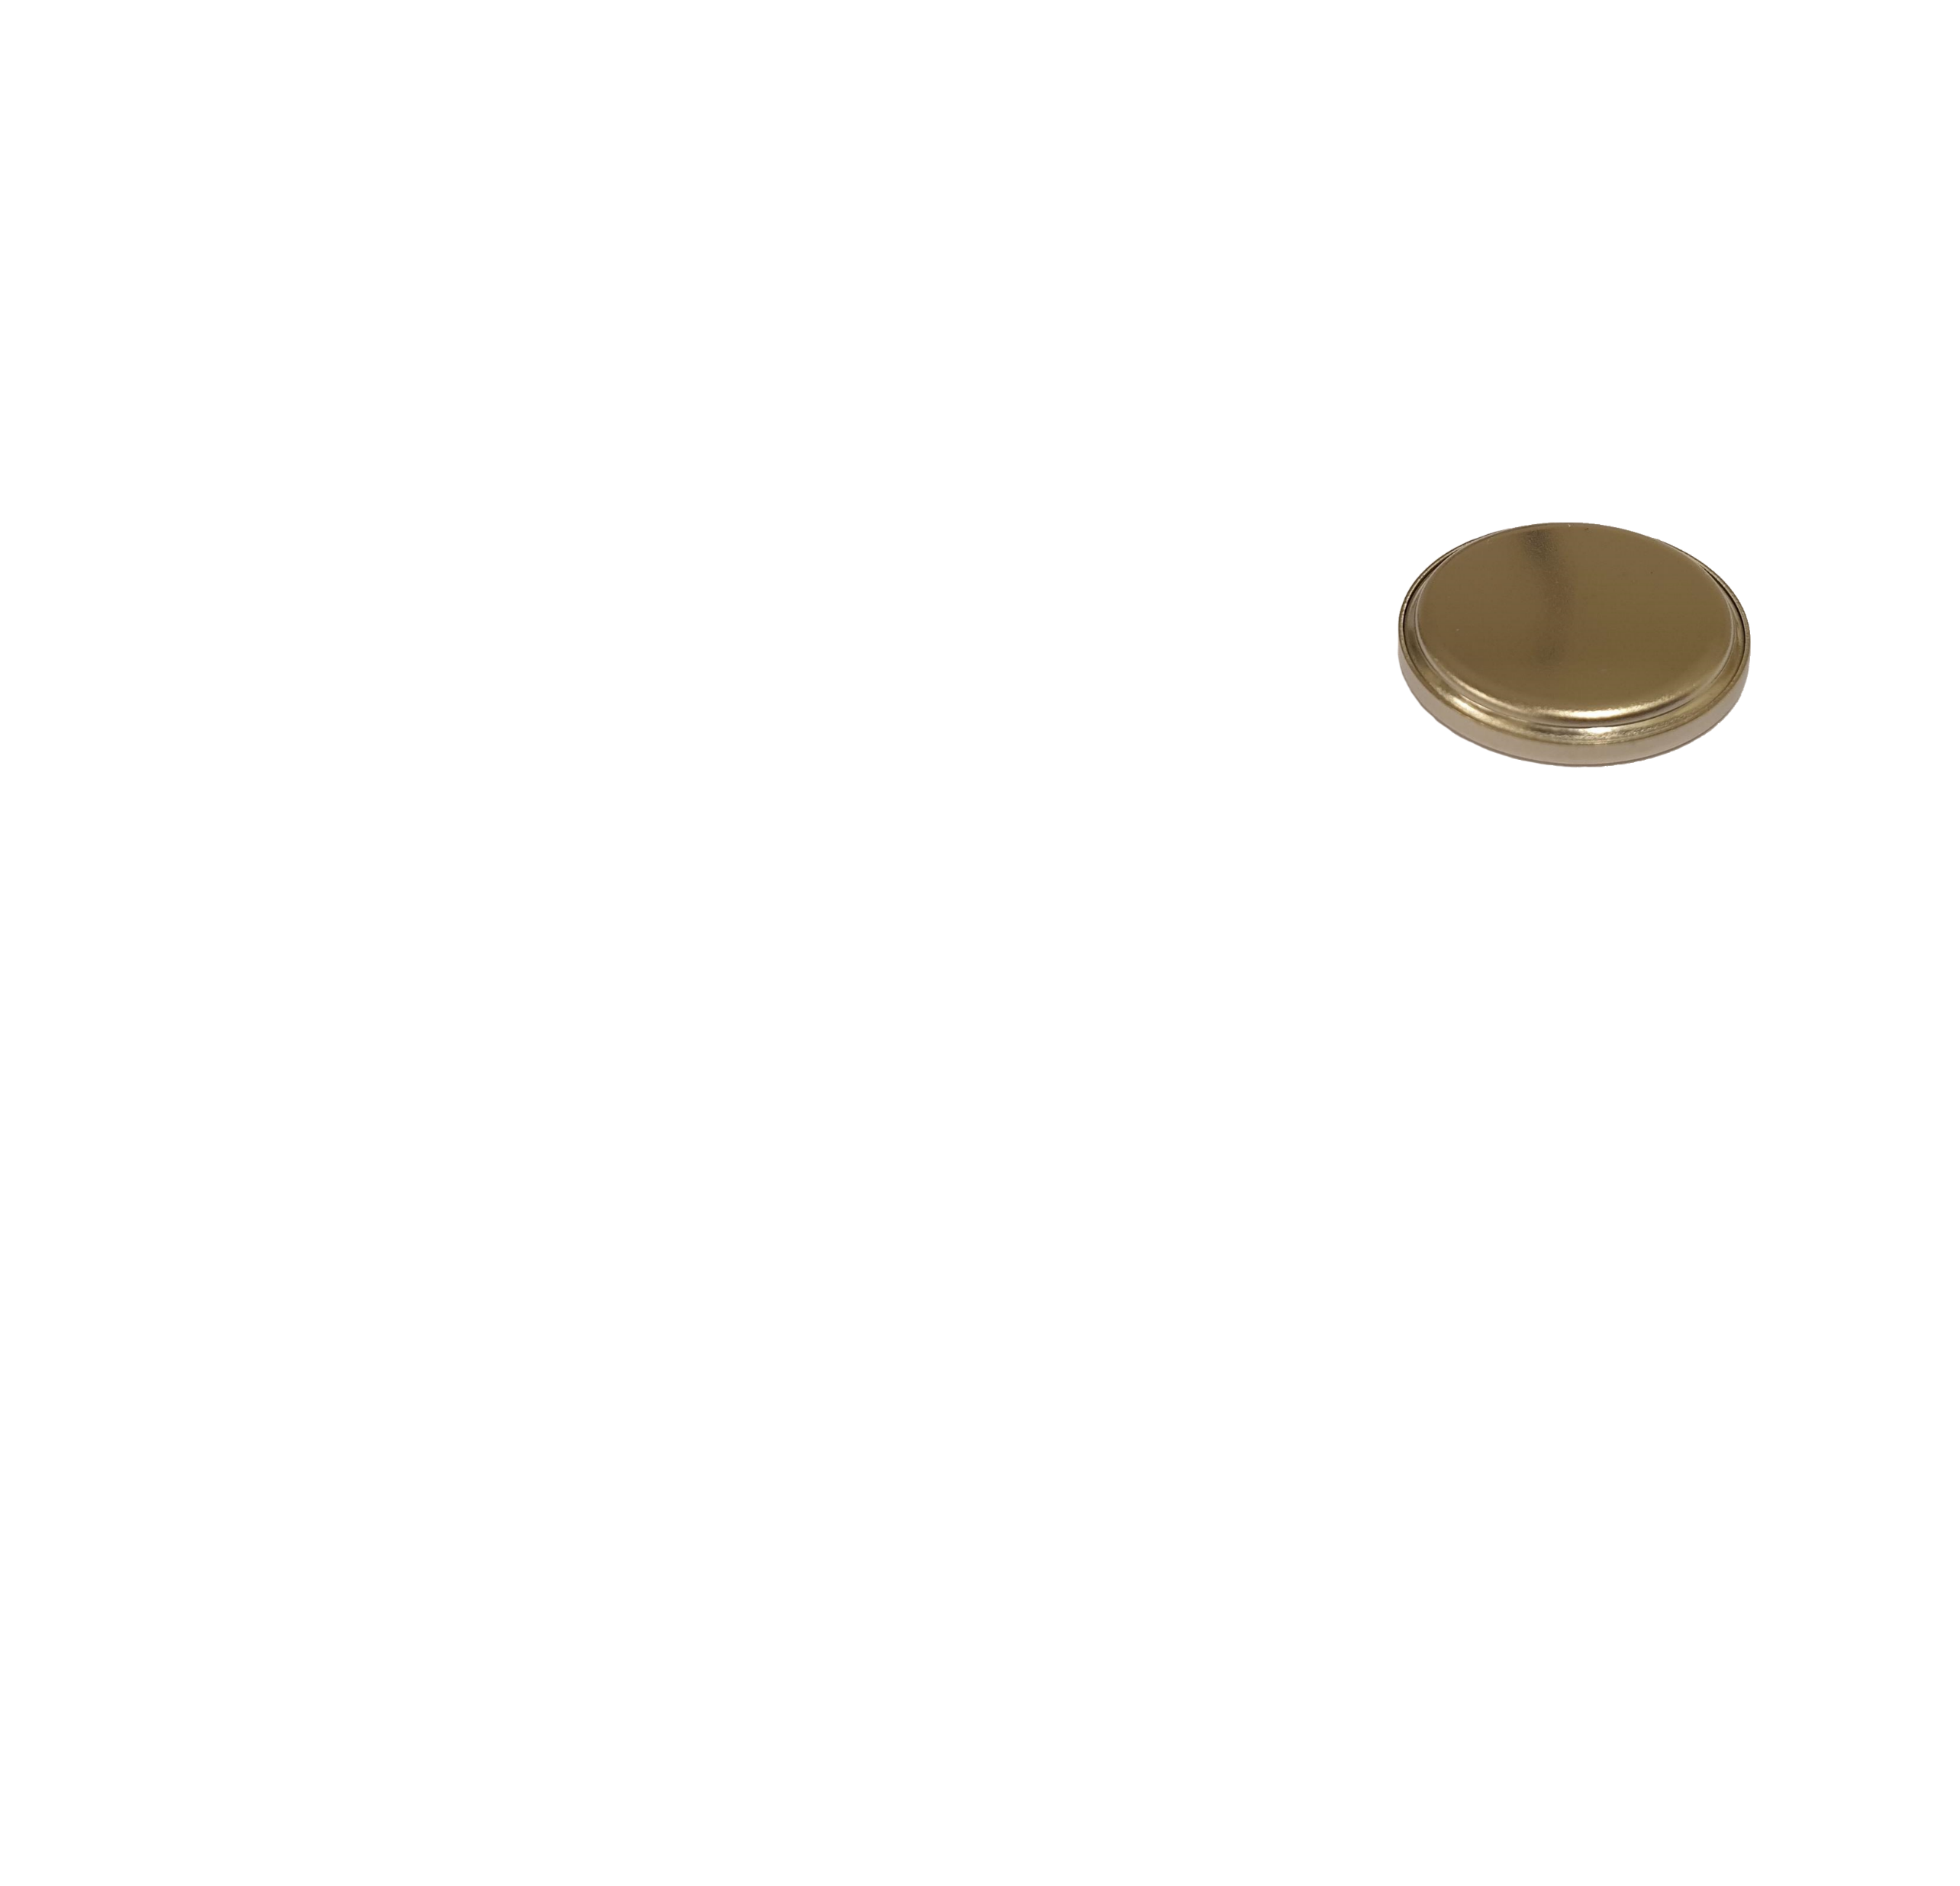
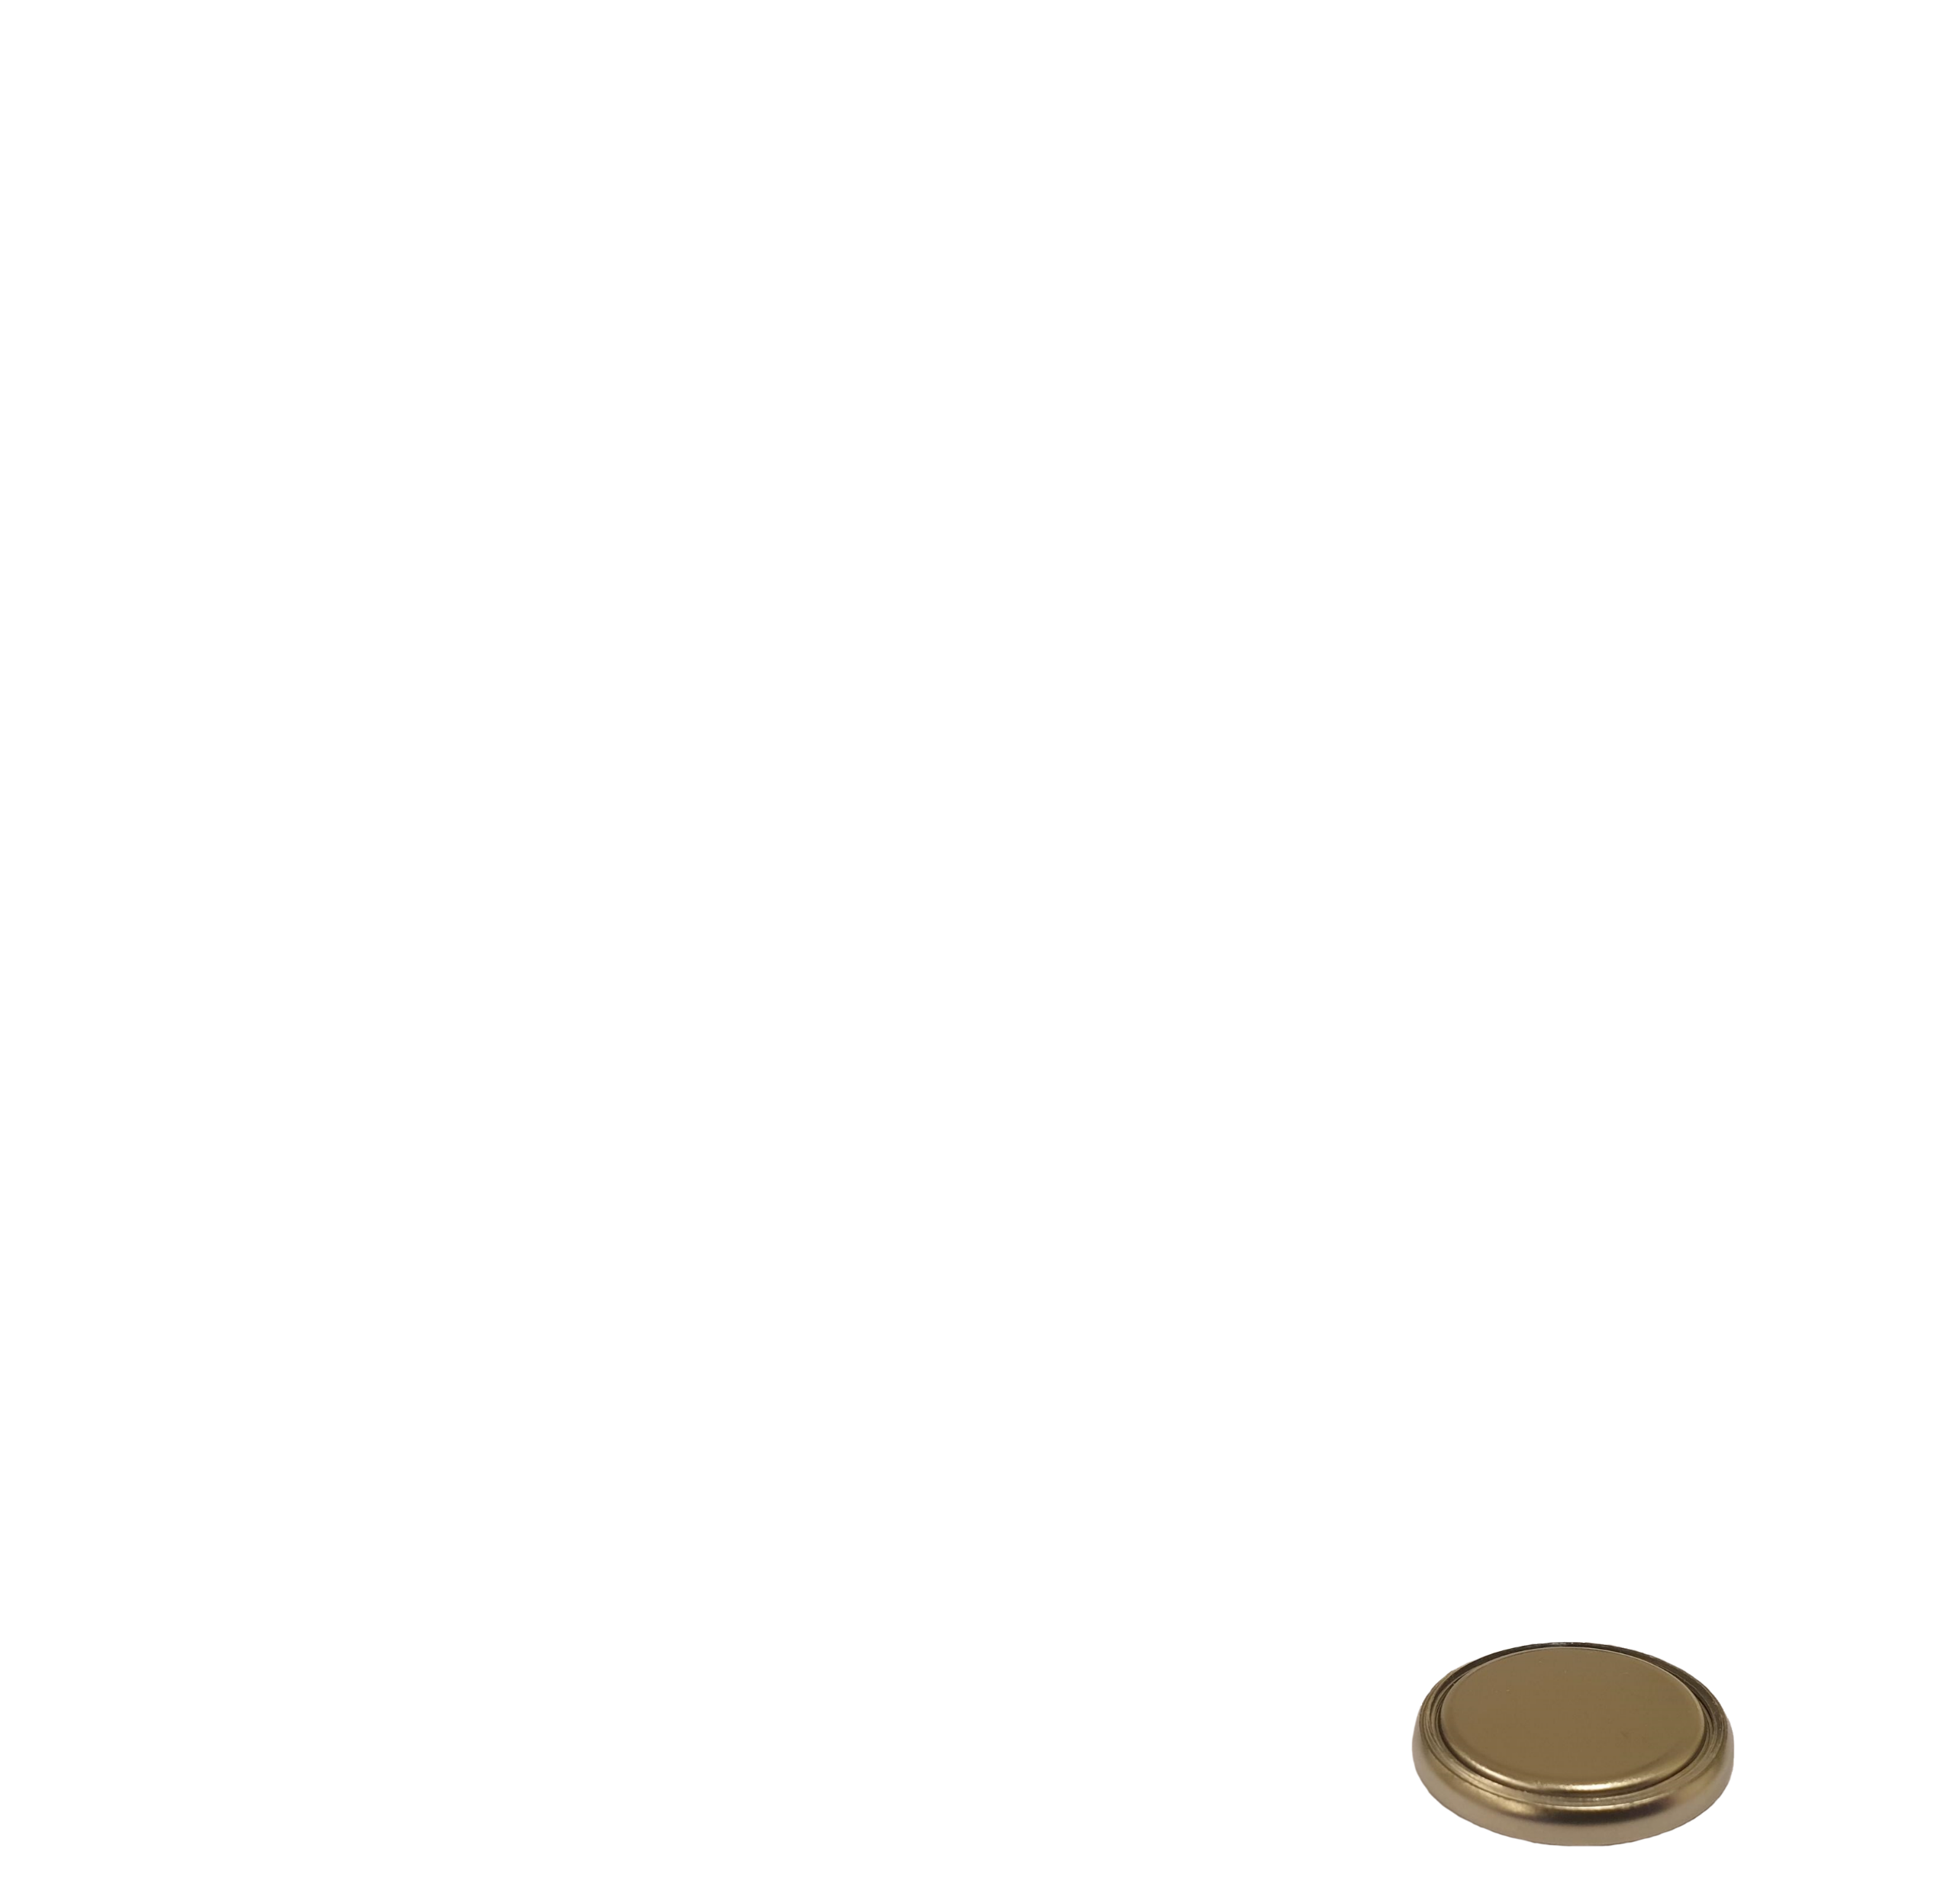
The C-cell
Cap
Spring
Spacer
Li
Separator
Cu
Gasket
Can

Slide 21
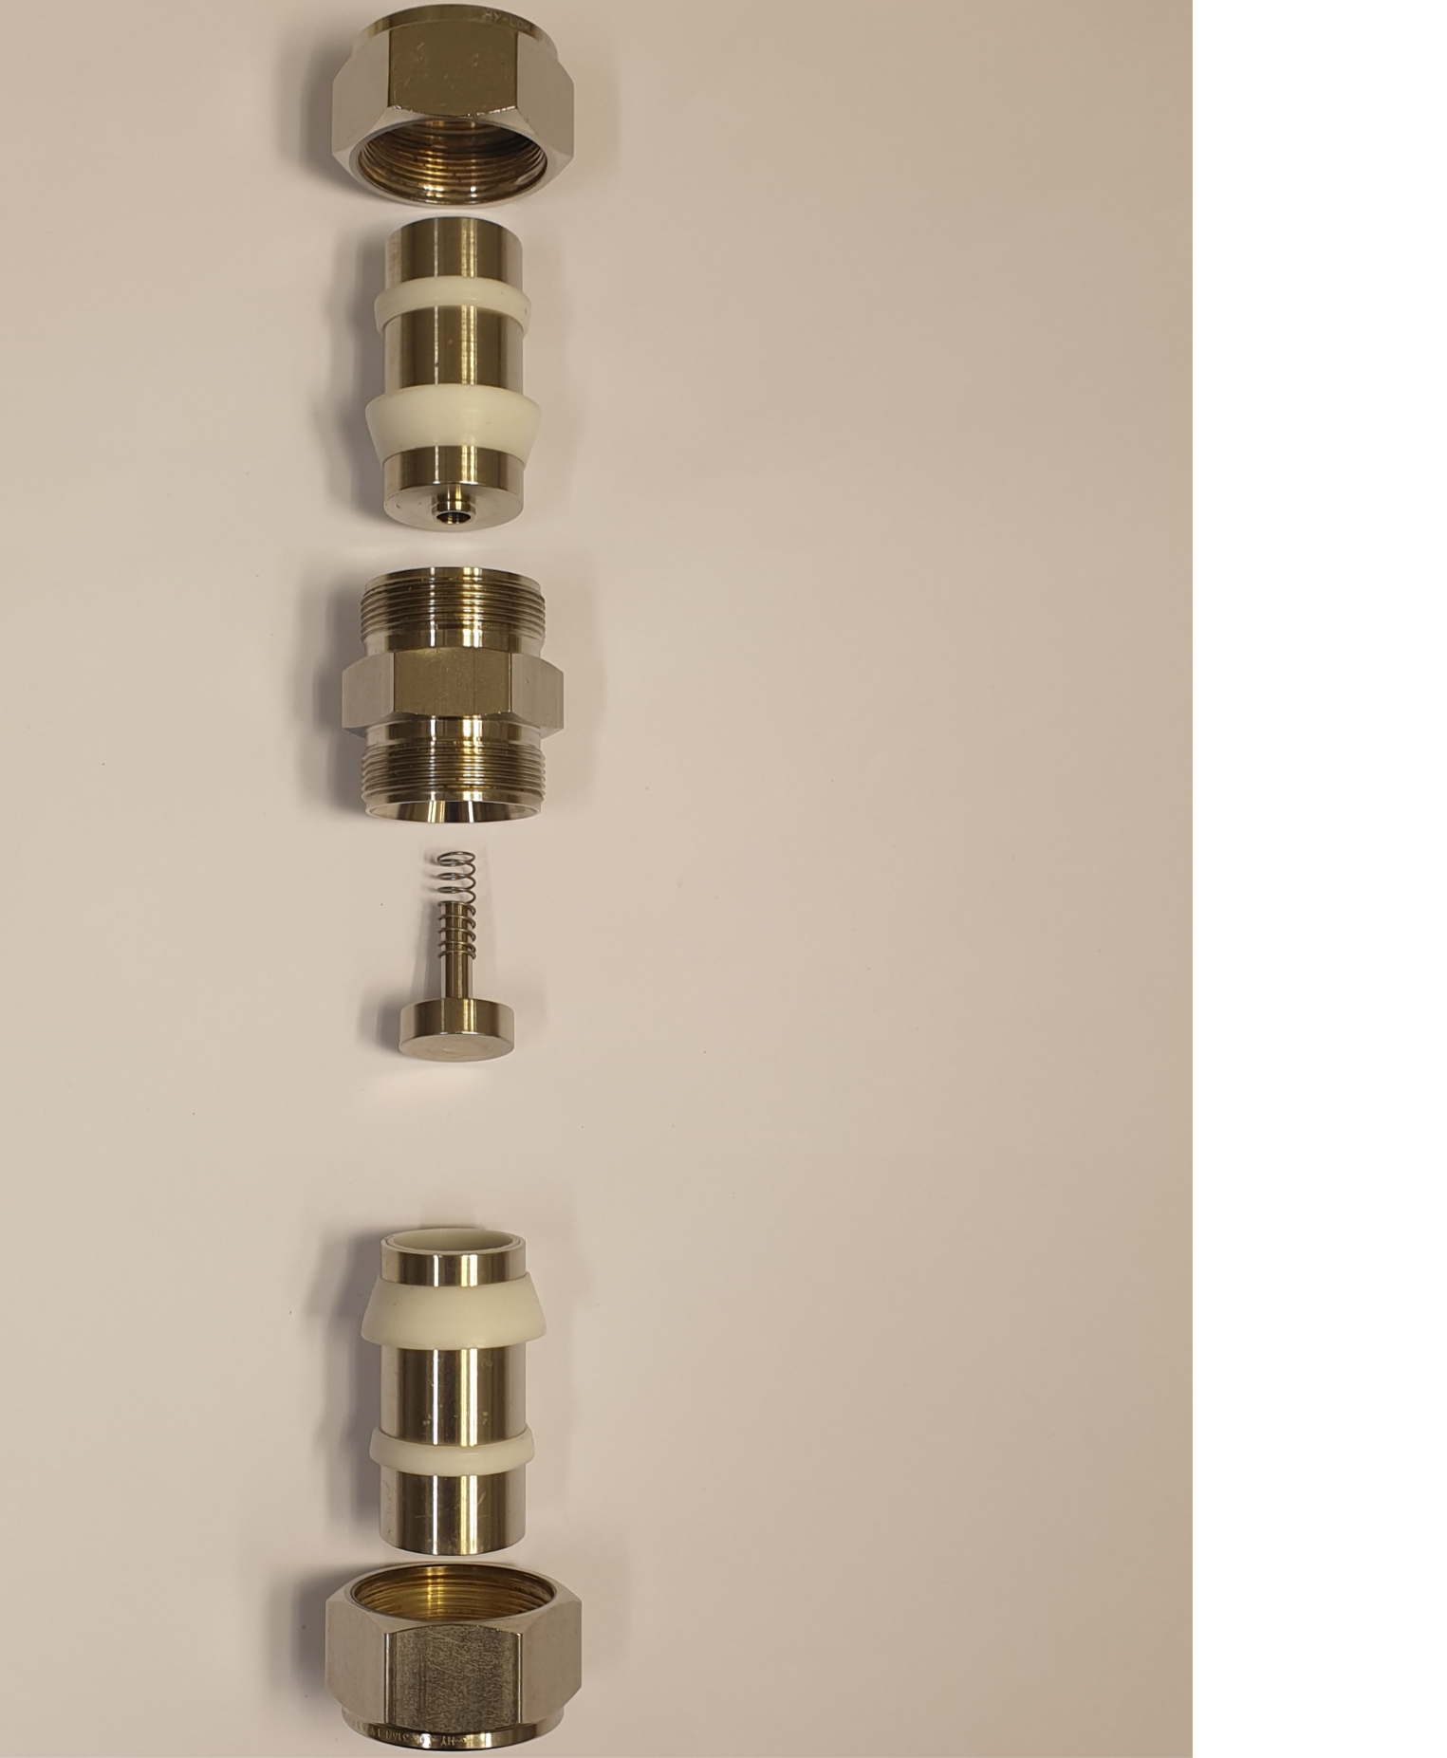
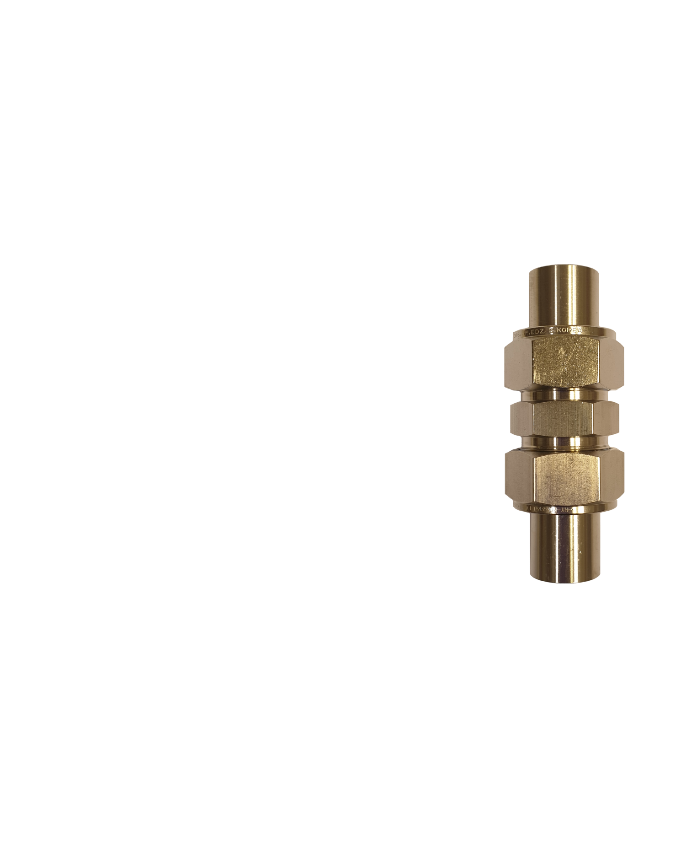

The I-cell
Nut
Metal rod
Sealing
rings
Main body
Spring
Spacer
Li
Separator
Cu

Slide 22
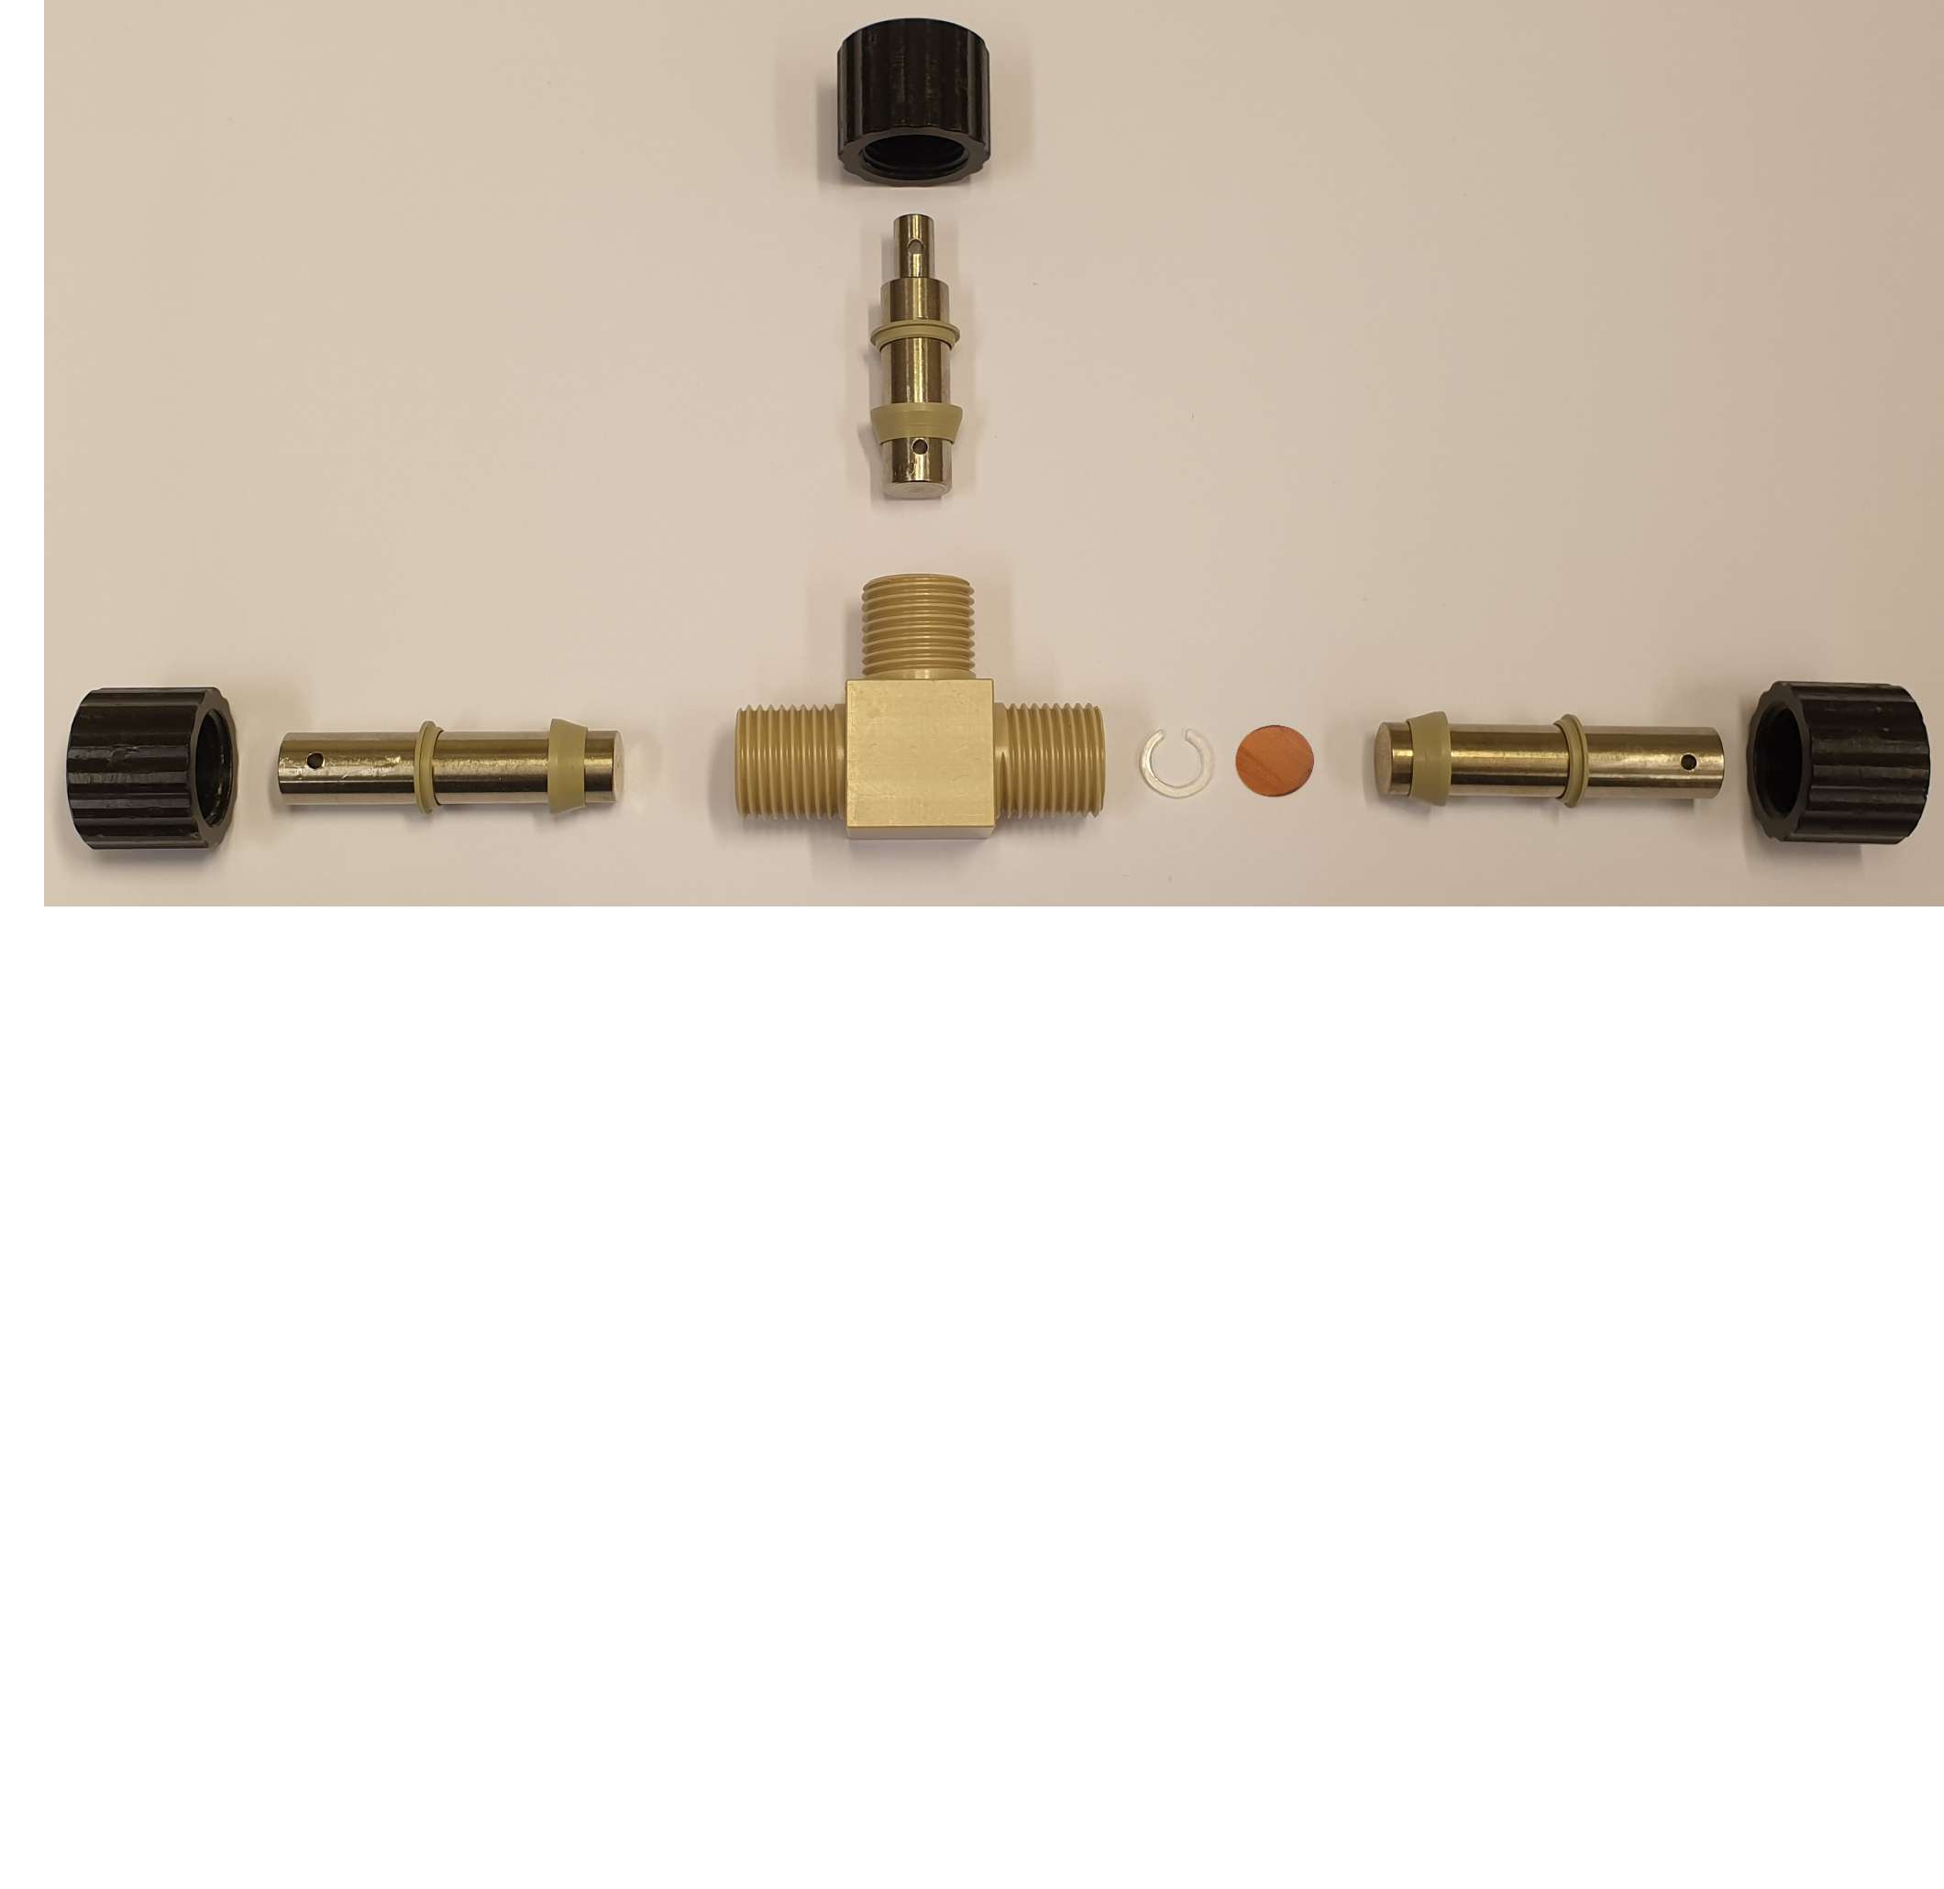

The T-cell
Nut
Metal rod
Sealing rings
Li
Main body
Spacer
Cu

Slide 23
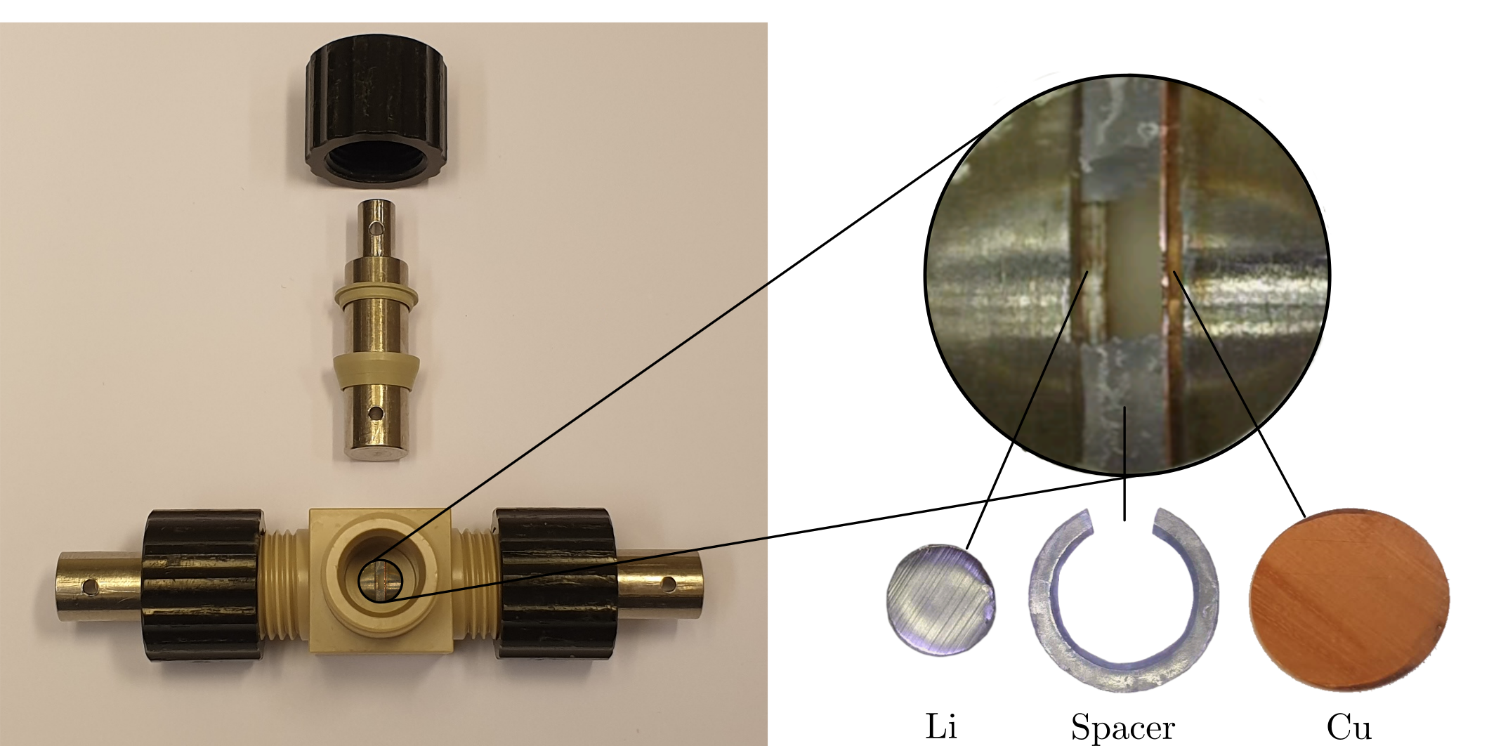
The T-cell

Slide 24
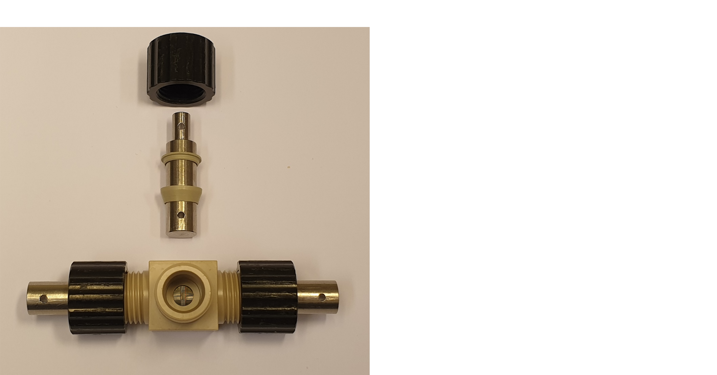
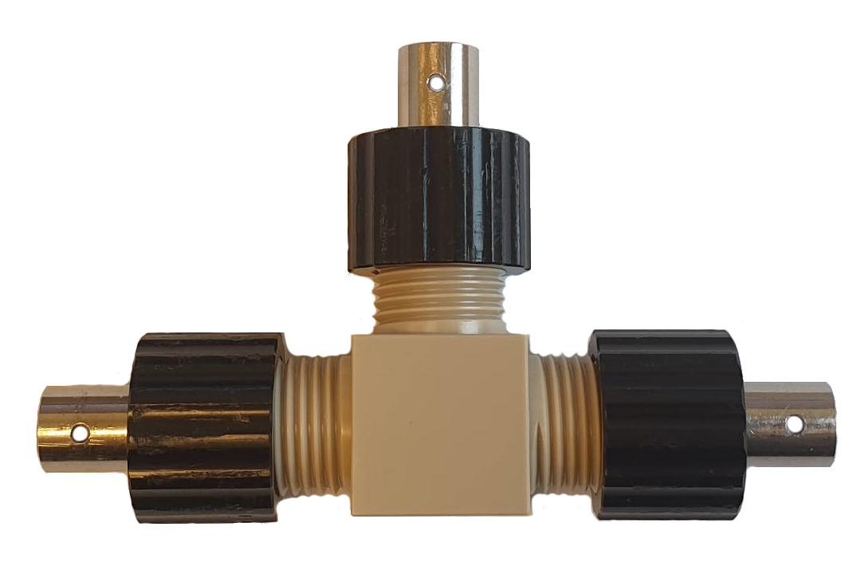
The T-cell

Slide 25
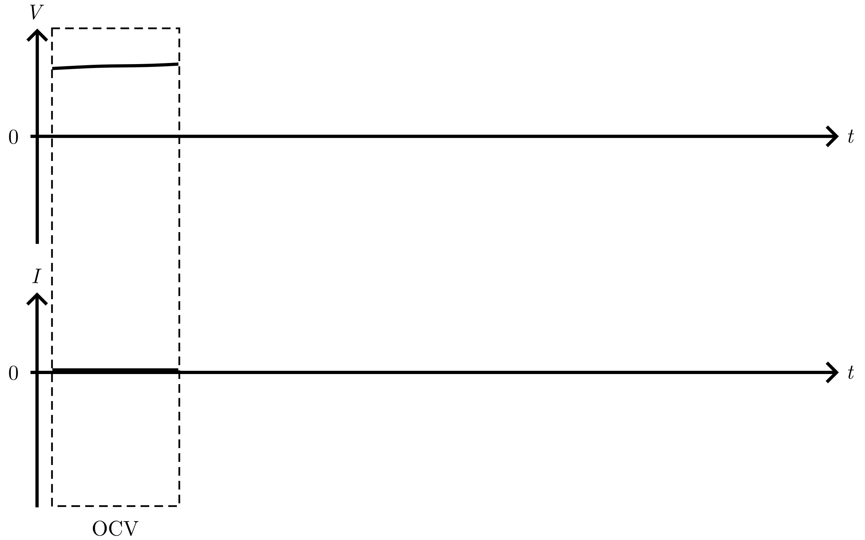
Cycling protocol

Slide 26
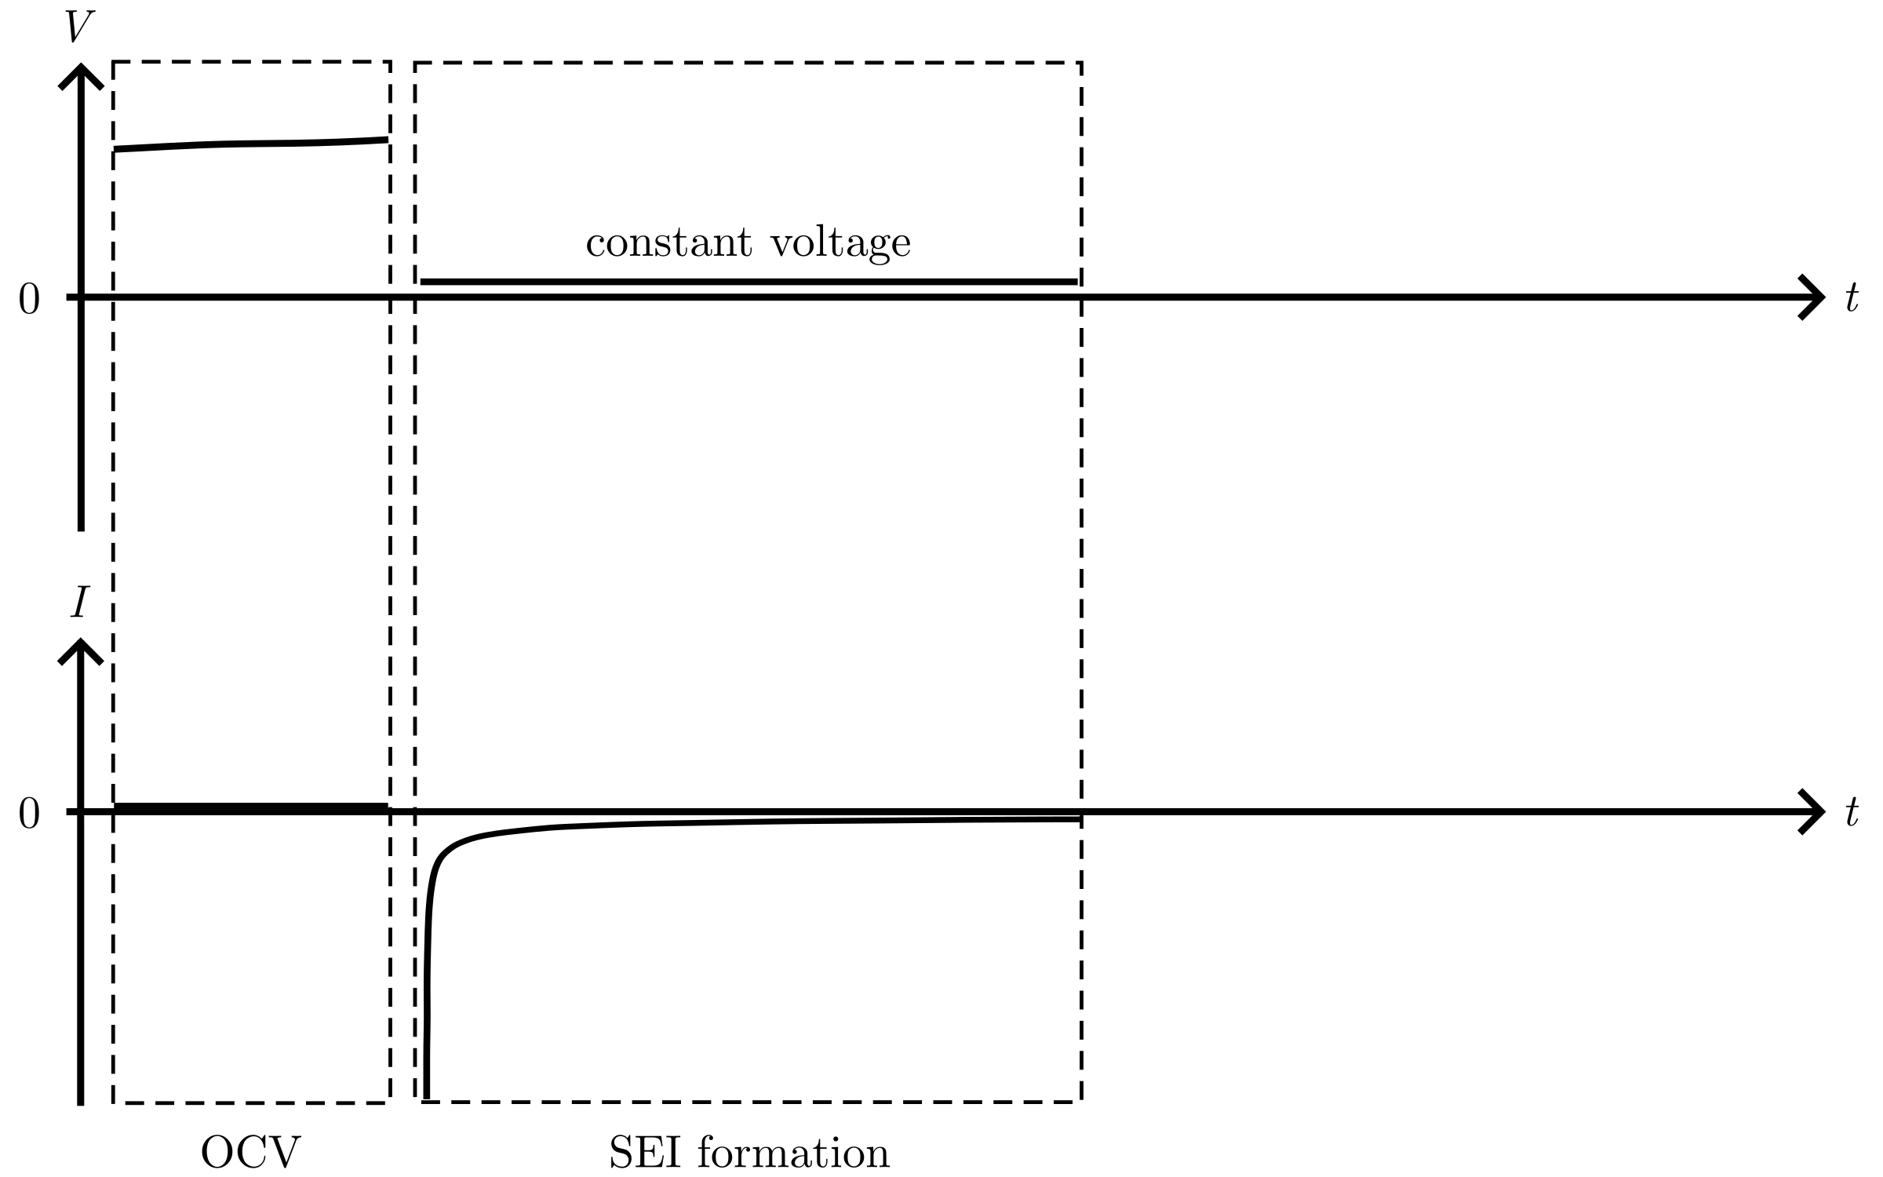
Cycling protocol

Slide 27
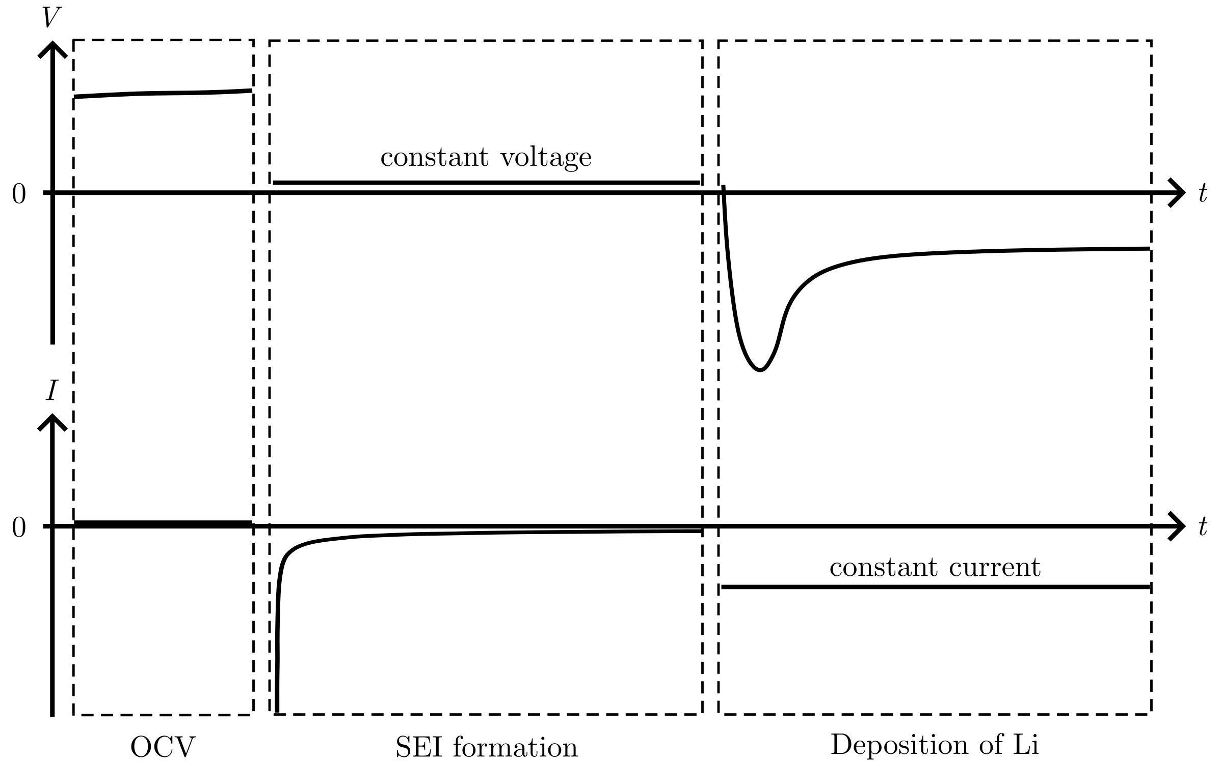
Cycling protocol

Slide 28
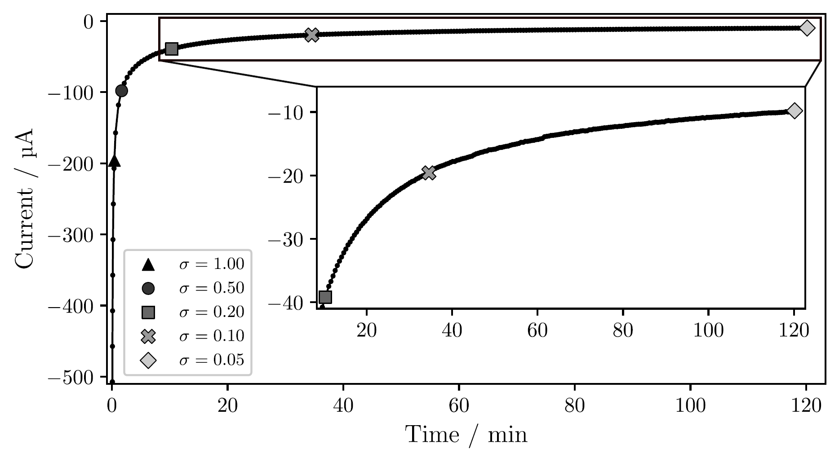
Passivation of the Cu surface
Notes:
T-cell, Jdeposition = 1 mAh/cm²
Time increase for lower sigma: 2 min for 0.50, 2 hour for 0.05, over 25 hours for 0.01

Slide 29
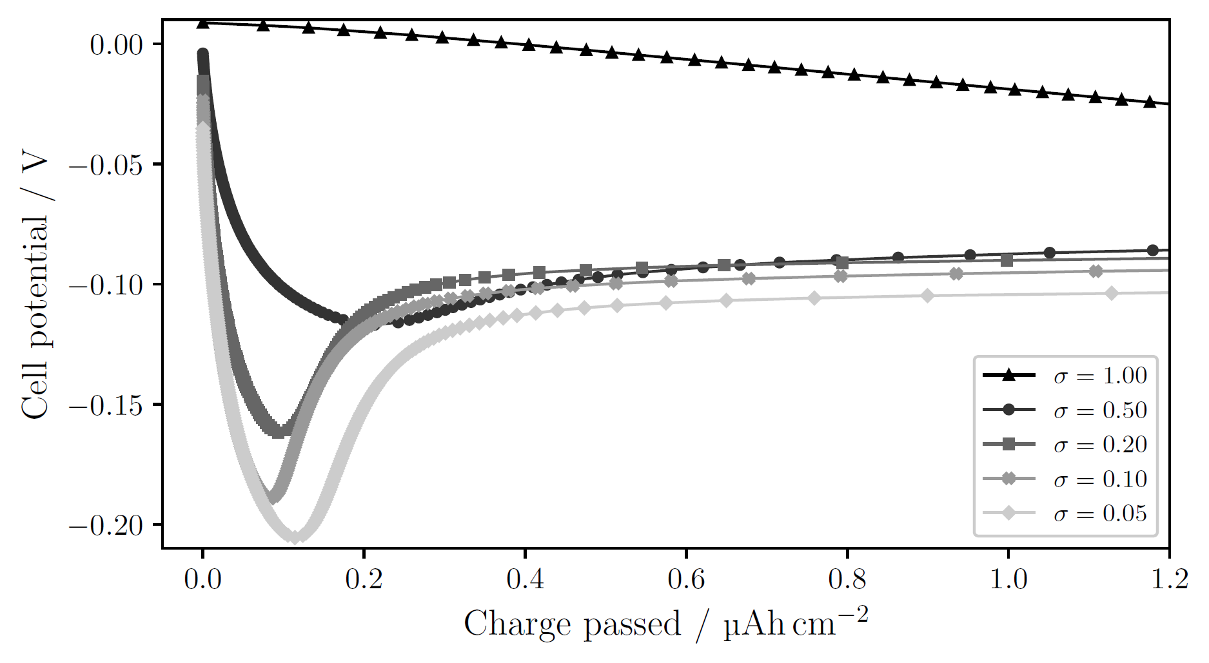
Passivation of the Cu surface
Notes:
T-cell, 1 mAh/cm²
sigma=1.00: no obvious nucleation; side reactions large enough to drive current without need for nucleation
Decreasing sigma → clearer deposition peak at higher overpotential
Larger overpotential → smaller nuclei, larger N → many sites for continued growth, lowering the necessity for further nucleation. Other words: more instantaneous nucleation (all nuclei form at the start and then they only grow).
Opposed to progressive nucleation, where nuclei continue to form as other grow

Slide 30
Different deposition currents

Slide 31
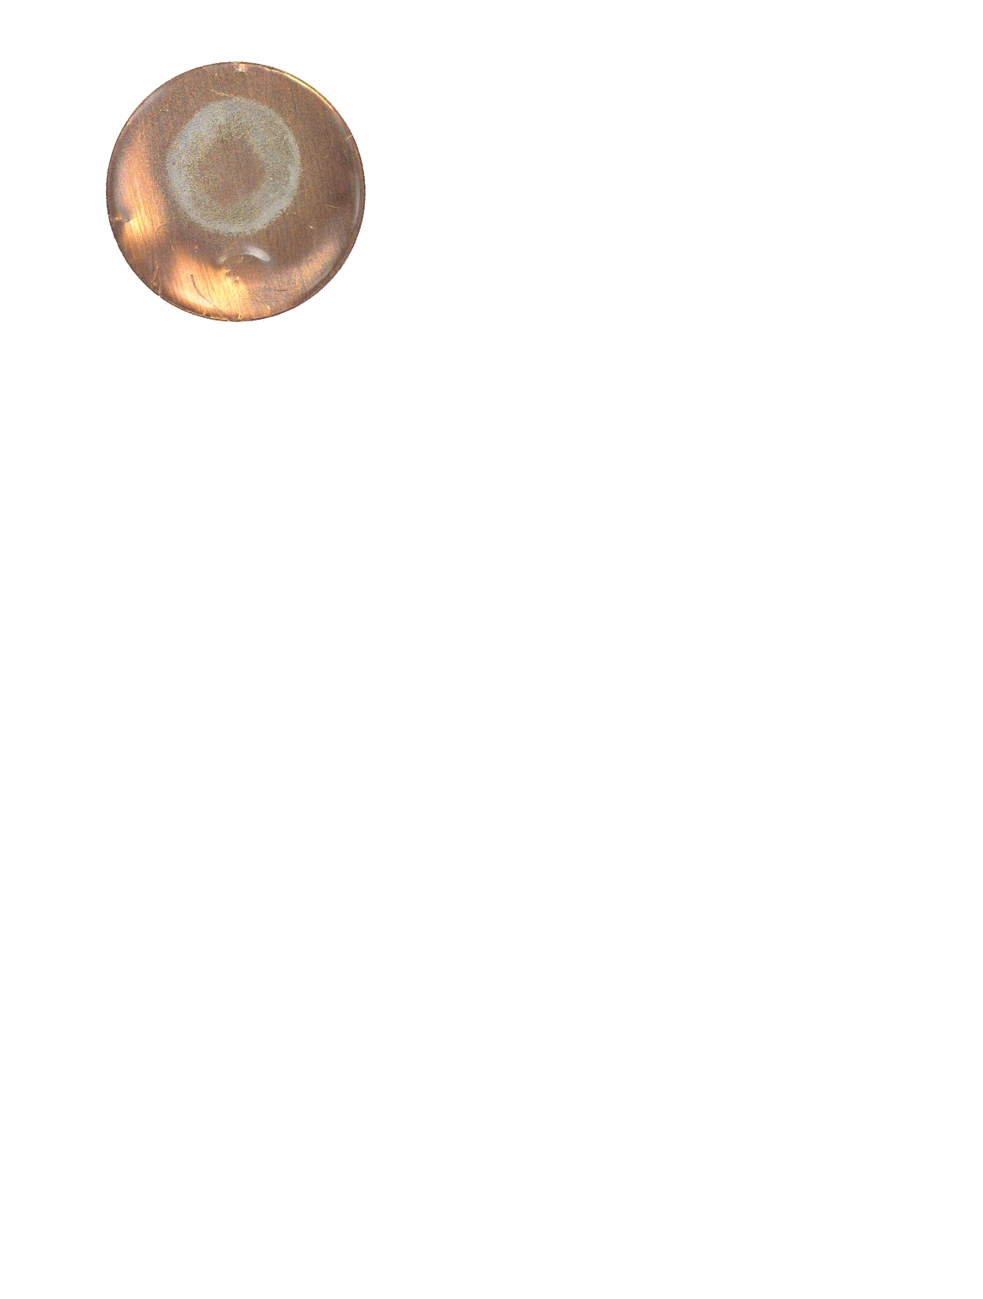
Pressure effects

Slide 32
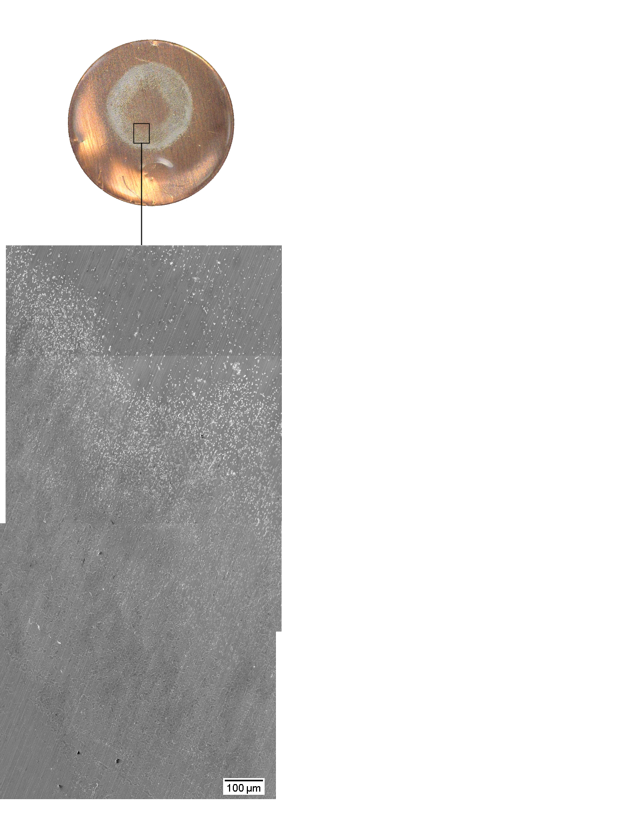
Pressure effects

Slide 33
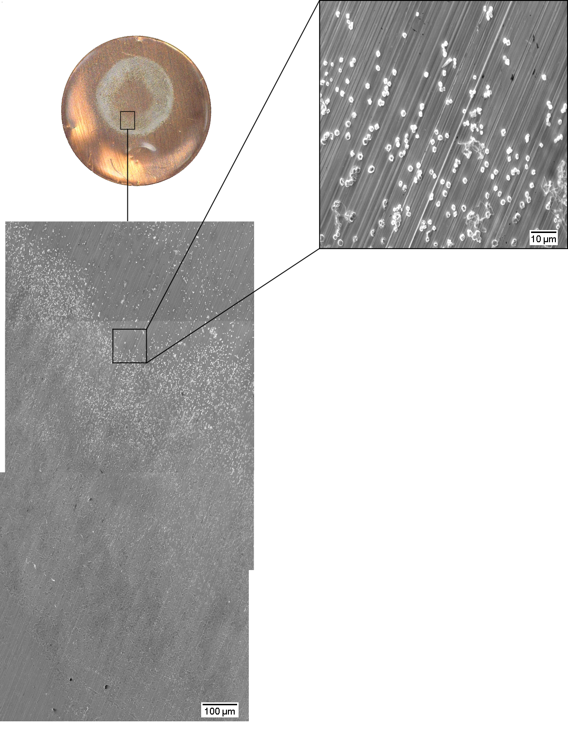
Pressure effects

Slide 34
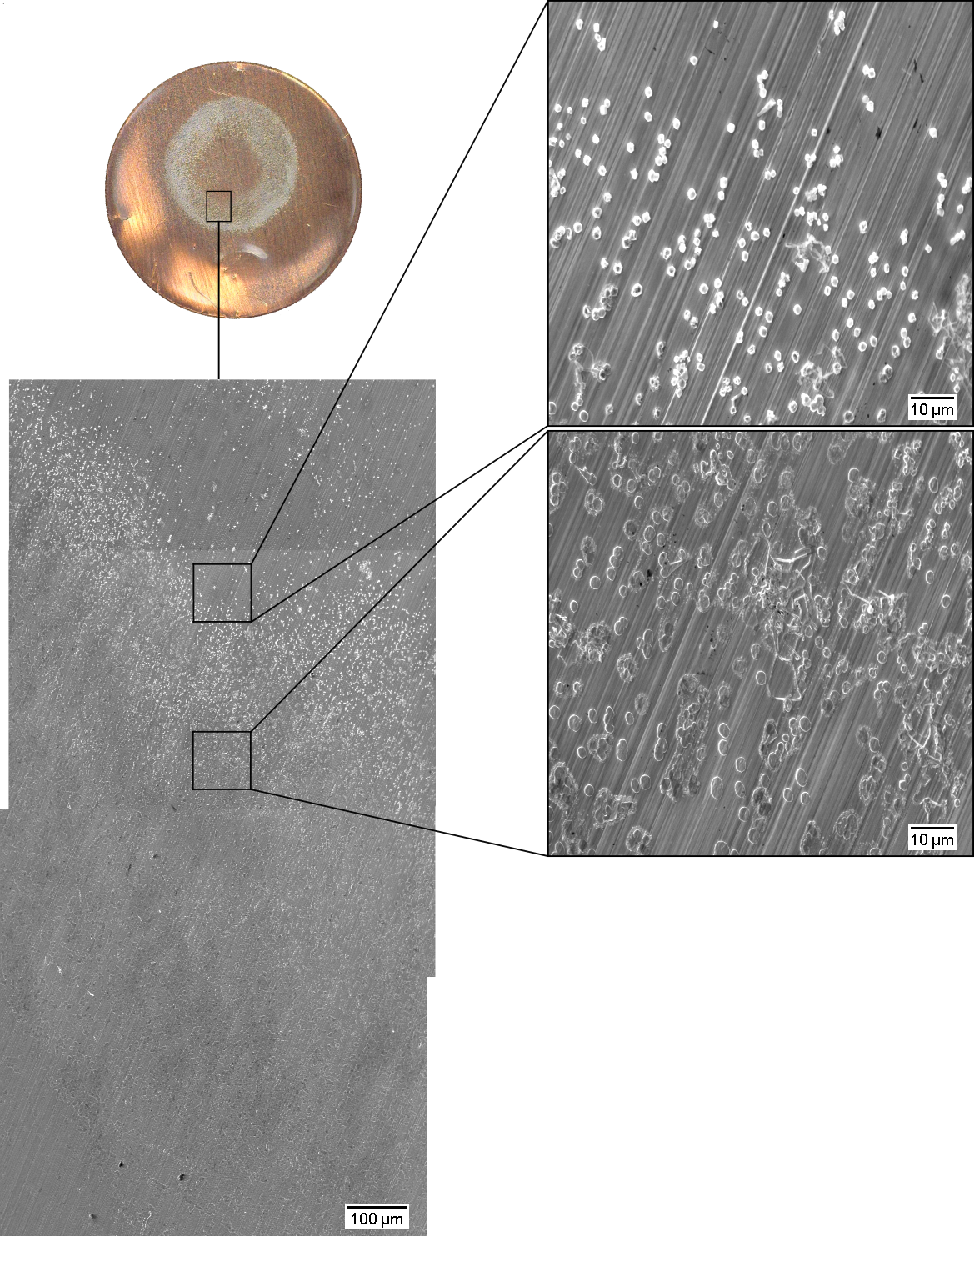
Pressure effects

Slide 35
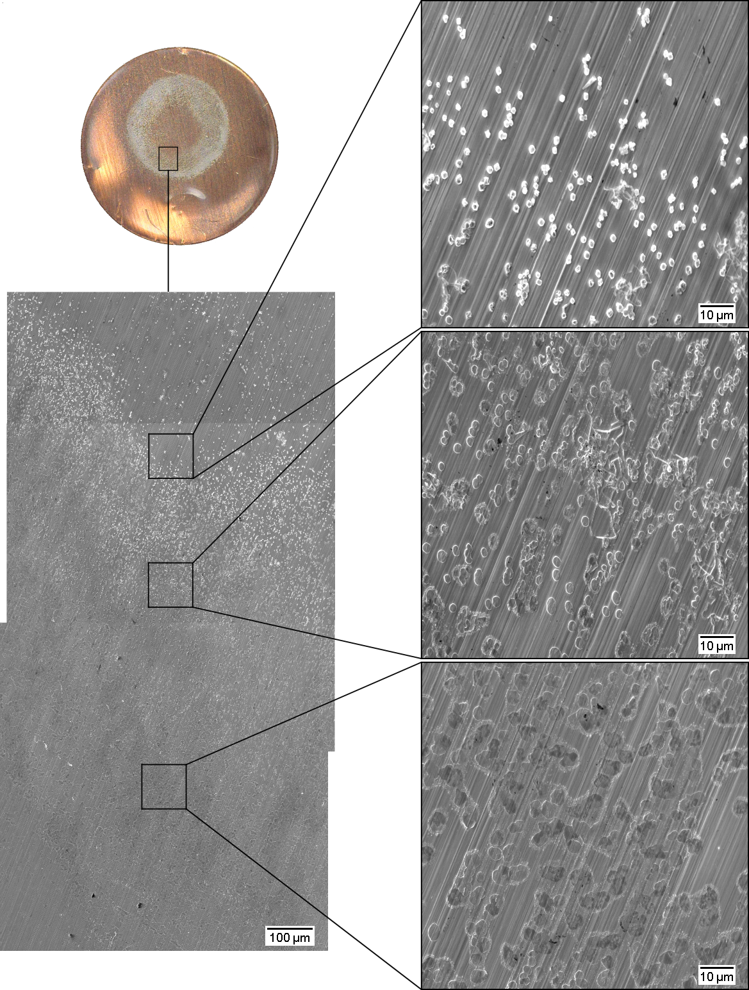
Pressure effects

Slide 36
Pressure effects
2r = 1 µm
2r = 2 µm to 3 µm
2r ≥ 4 µm

Slide 37
Pressure effects
2r = 1 µm
N = 0.024 nuclei/µm²
2r = 2 µm to 3 µm
N = 0.022 nuclei/µm²
2r ≥ 4 µm
N = 0.016 nuclei/µm²

Slide 38
Pressure effects
2r = 1 µm
N = 0.024 nuclei/µm²
2r = 2 µm to 3 µm
N = 0.022 nuclei/µm²
2r ≥ 4 µm
N = 0.016 nuclei/µm²

Slide 39
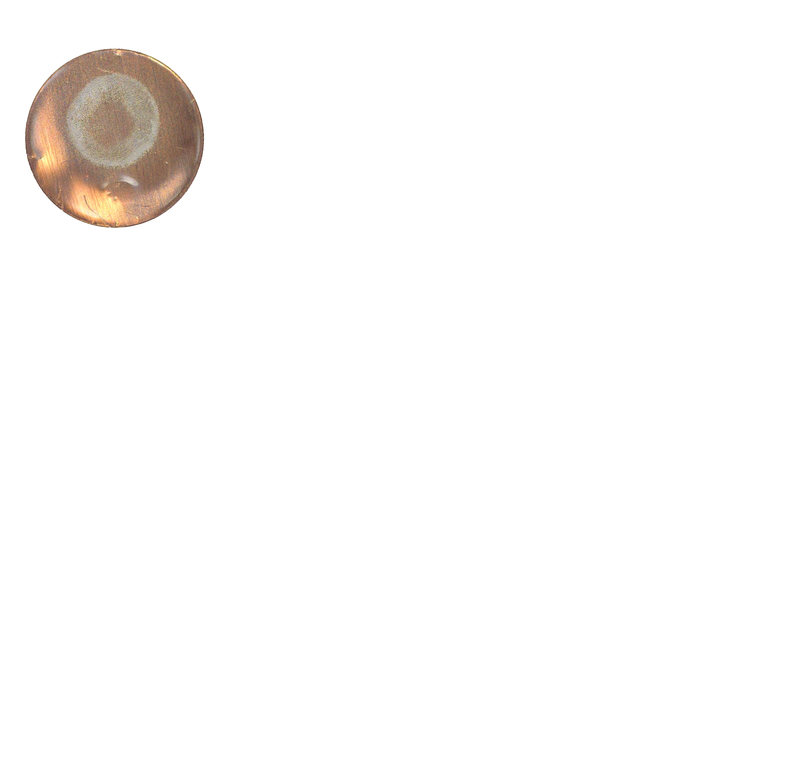
Pressure effects

Slide 40
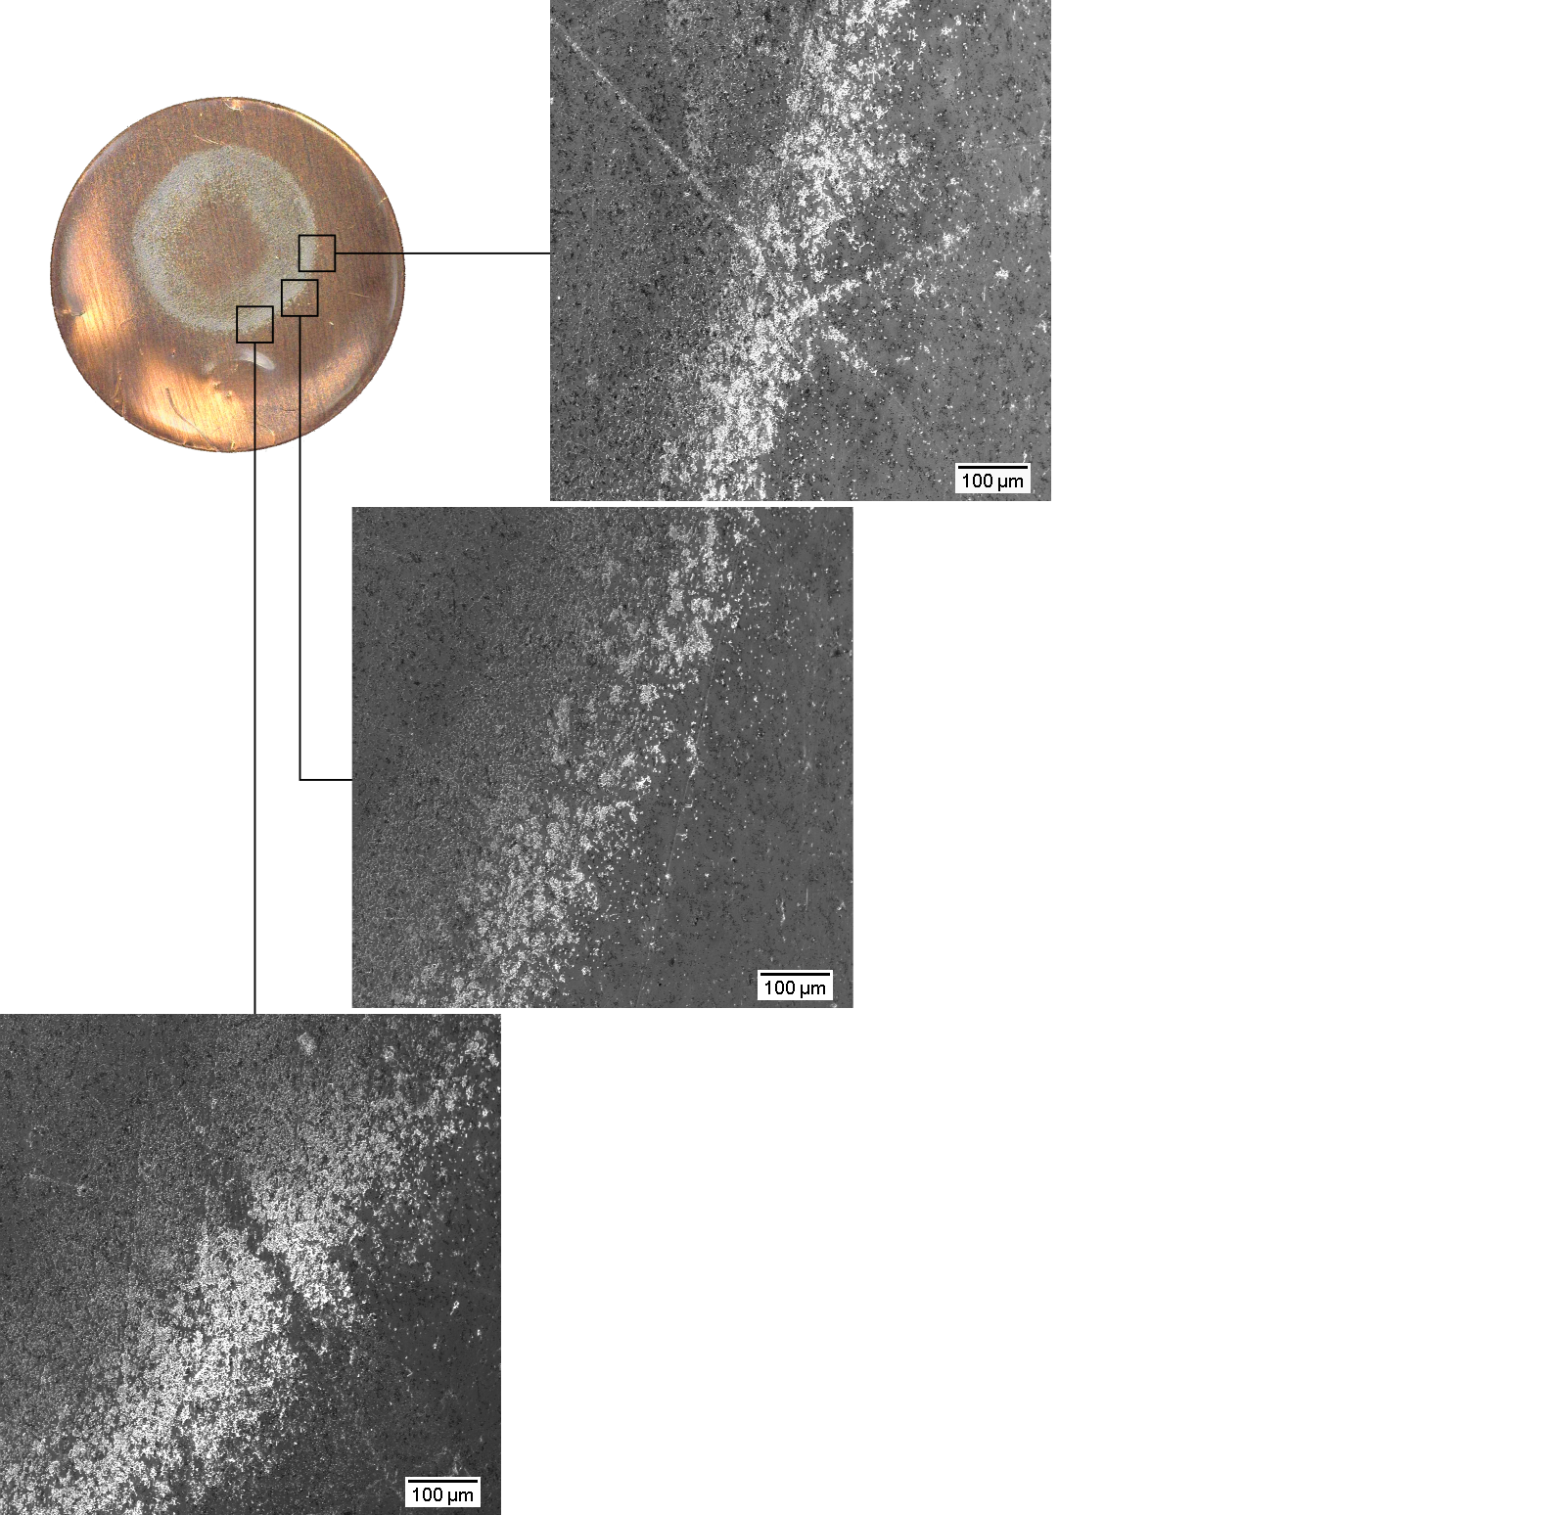
Pressure effects

Slide 41
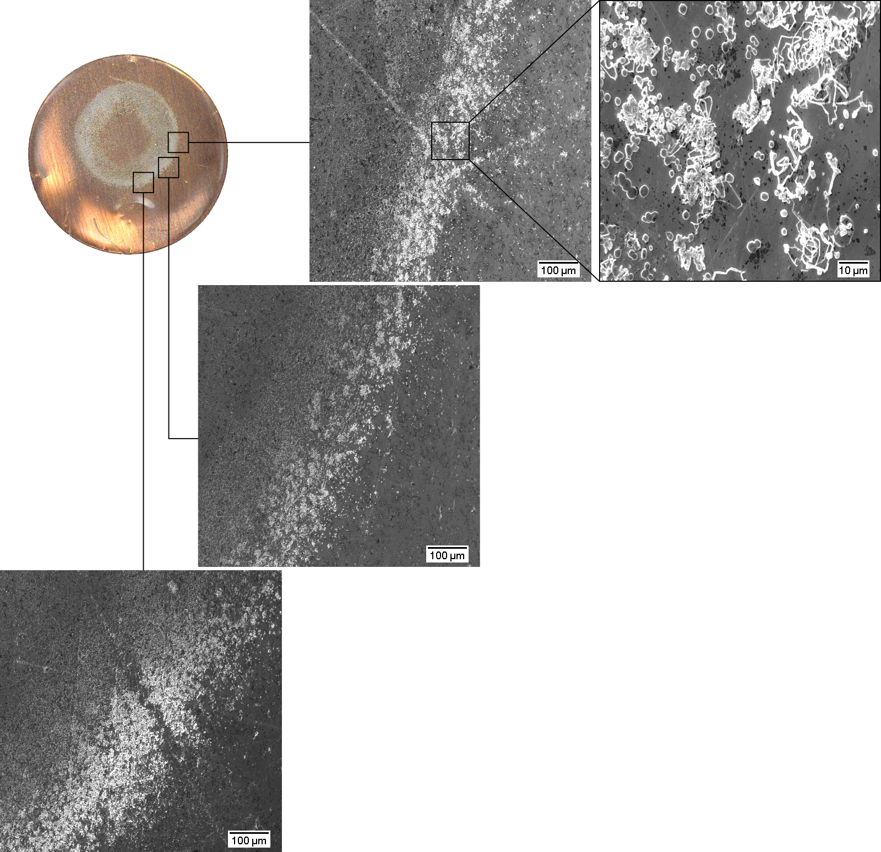
Pressure effects

Slide 42
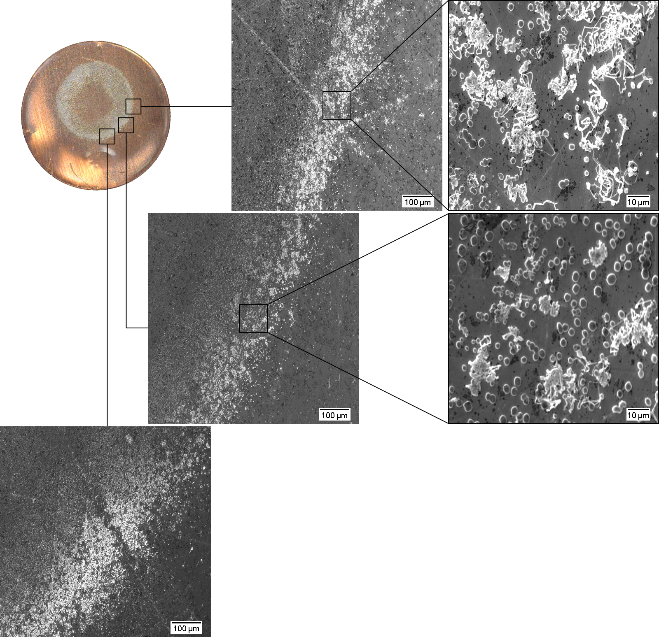
Pressure effects

Slide 43
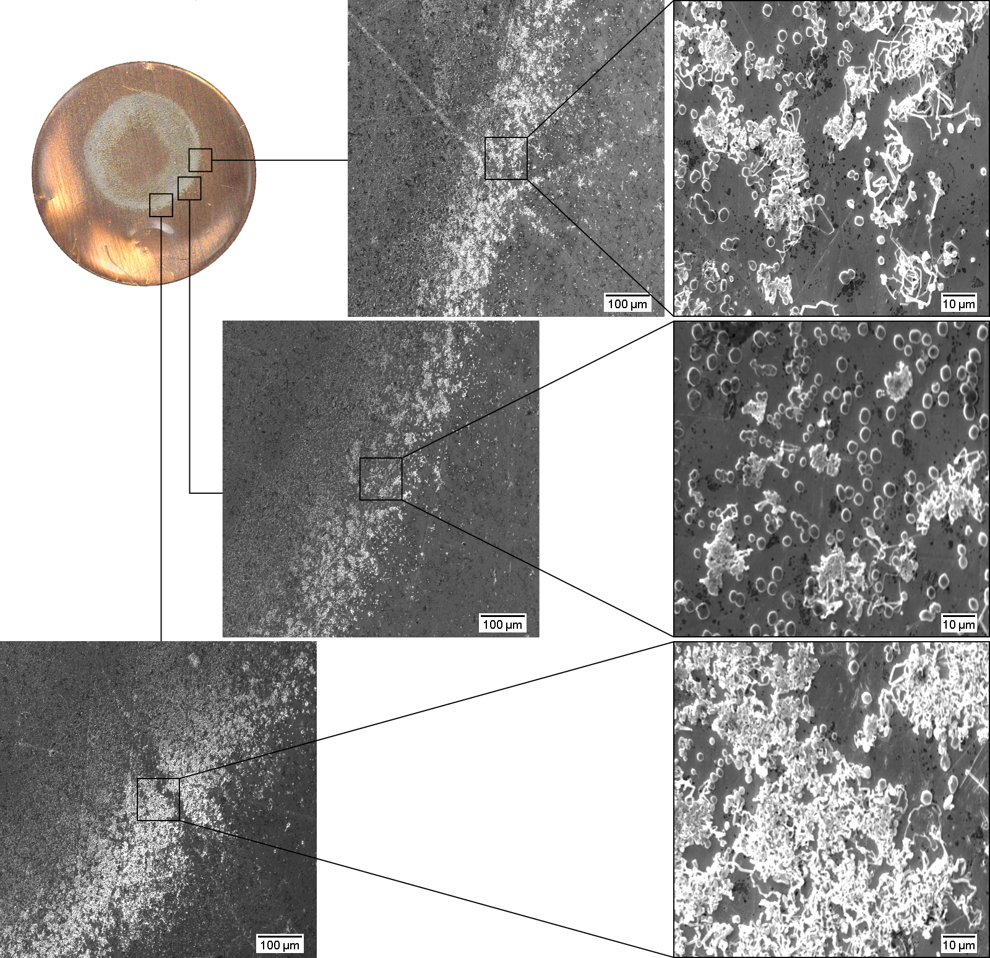
Pressure effects

Slide 44
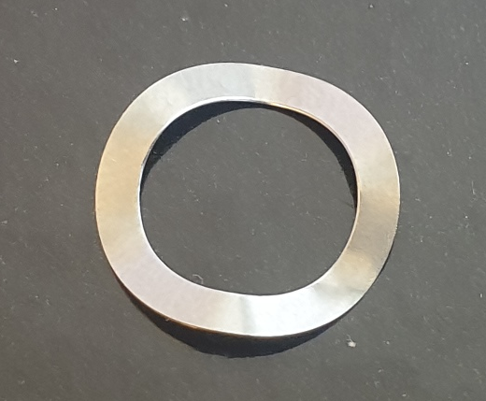
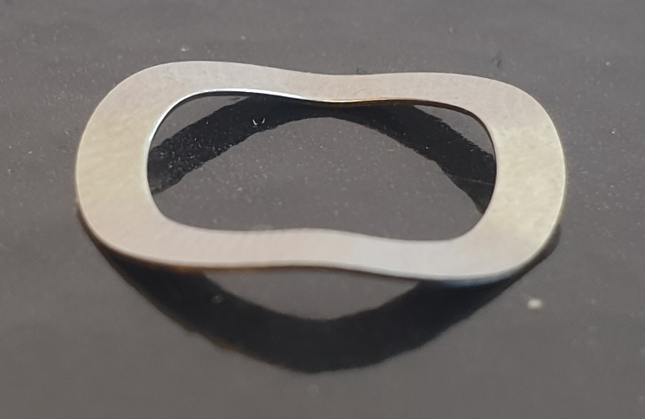
Pressure effects

Slide 45
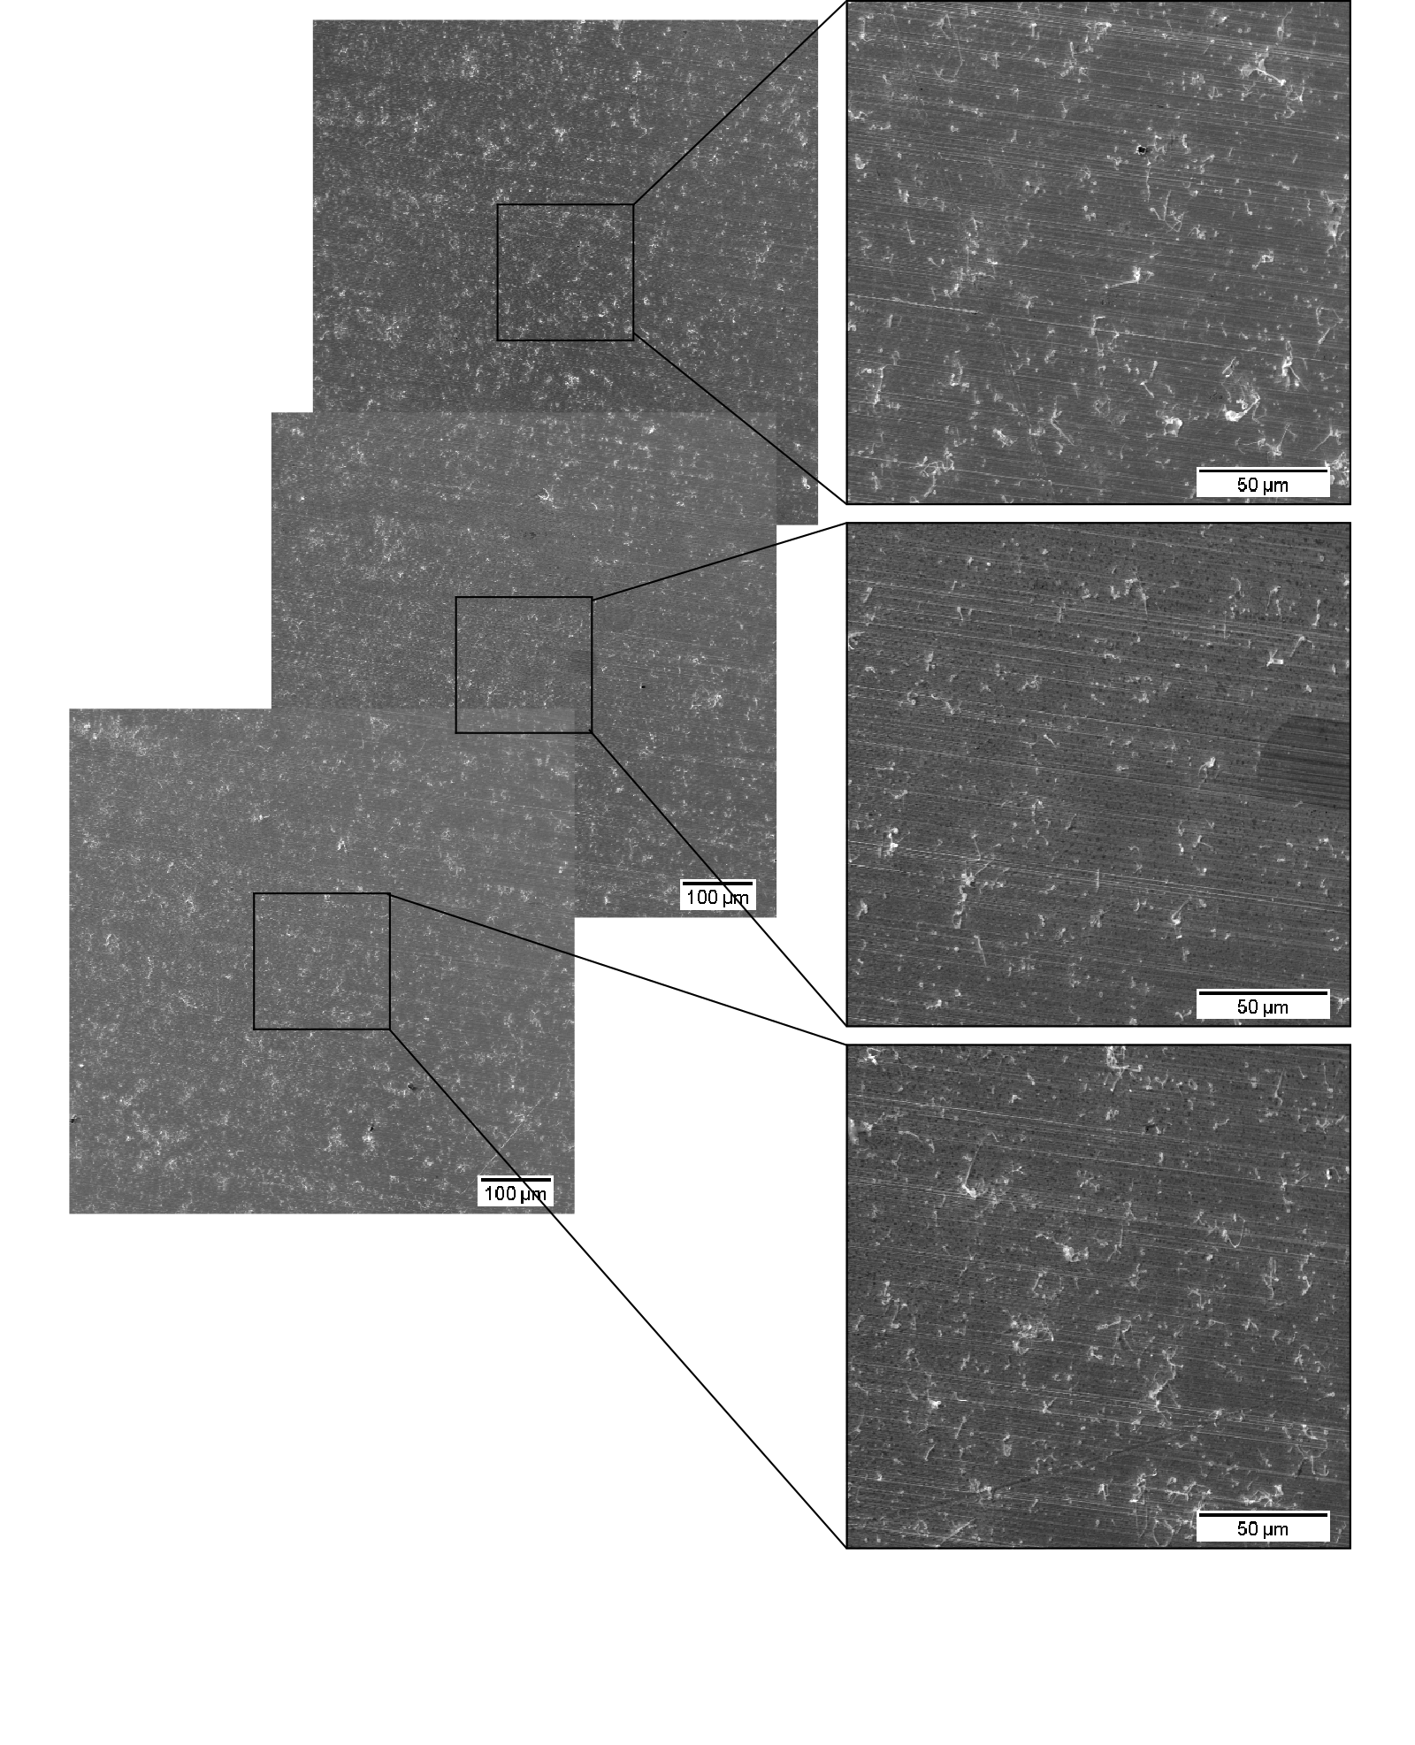
Pressure effects

Slide 46
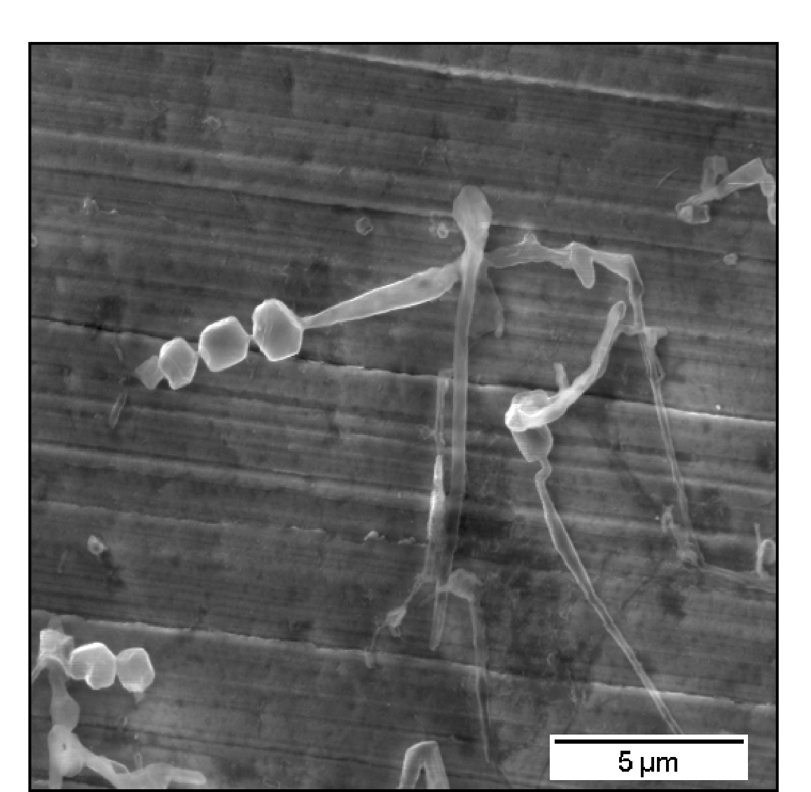
Pressure effects

Slide 47
Pressure effects

Slide 48
Pressure effects

Slide 49
Conclusions

Slide 50
//
Tank for listen.

Slide 51
Electrochemical deposition of lithium on copper
Gottfrid Olsson
2024-05-21

